Slide 1
18CSS202J- COMPUTER COMMUNICATION UNIT 3

Slide 2
Course Objective:
The purpose of learning this course is to
Understand the basic services and concepts related to Internetwork
Understand the layered network architecture
Acquire knowledge in IP addressing
Exploring the services and techniques in physical layer
Understand the functions of Data Link layer
Implement and analyze the different Routing Protocols
Course Outcomes (CO):
At the end of this course, learners will be able to
Apply the knowledge of communication
Identify and design the network topologies
Design the network using addressing schemes
Identify and correct the errors in transmission
Identify the guided and unguided transmission media
Implement the various Routing Protocols

Slide 3
TOPICS TO BE LEARNED:
Line Coding Schemes: Unipolar, Polar and Bipolar.
Amplitude Shift Keying Technique, Frequency Shift Keying Technique and Phase Shift Keying Technique, Pulse Code Modulation, Delta Modulation
Multiplexing: Frequency Division Multiplexing(FDM)
Time Division Multiplexing(TDM), Wavelength Division Multiplexing(WDM)
Guided Media: Twisted pair, coaxial and Fiber optic cables, Unguided Media: Radio waves.
Microwaves and Infrared.

Slide 4
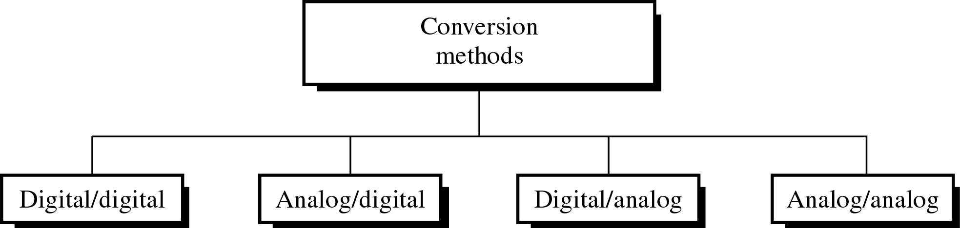
Different Conversion Schemes

Slide 5
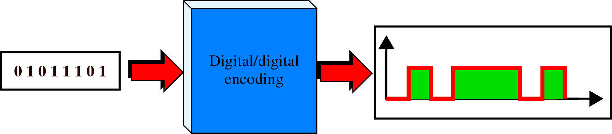
Digital to Digital Encoding

Slide 6
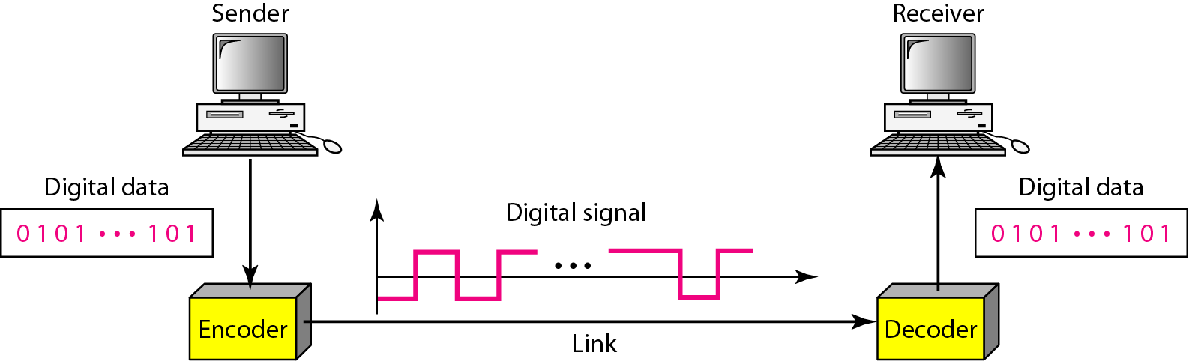
Line coding and decoding

Slide 7
DIGITAL-TO-DIGITAL CONVERSION -LINE CODING
Data can be either digital or analog. Signals that represent data can also be digital or analog. In this section, we see how we can represent digital data by using digital signals.
The conversion involves three techniques:
LINE CODING
BLOCK CODING
SCRAMBLING.
Line coding is always needed; block coding and scrambling may or may not be needed.
Line coding is used to convert digital data to a digital signal.

Slide 8
Line Coding
Line coding is the process of converting digital data to digital signals
Converting a string of 1’s and 0’s (digital data) into a sequence of signals that denote the 1’s and 0’s.
For example a high voltage level (+V) could represent a “1” and a low voltage level (0 or -V) could represent a “0”.

Slide 9
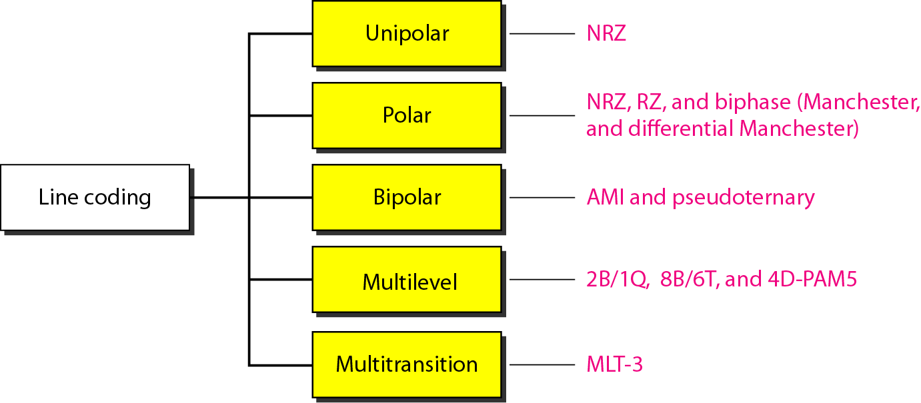
Figure Line coding schemes

Slide 10
Unipolar
All signal levels are on one side of the time axis , either above or below.
+v define 1 and –v define 0.
NRZ - Non Return to Zero scheme is an example of this code. The signal level does not return to zero at a middle of the bit.
Scheme is prone to baseline wandering and DC components. It has no synchronization or any error detection. It is simple but costly in power consumption.

Slide 11
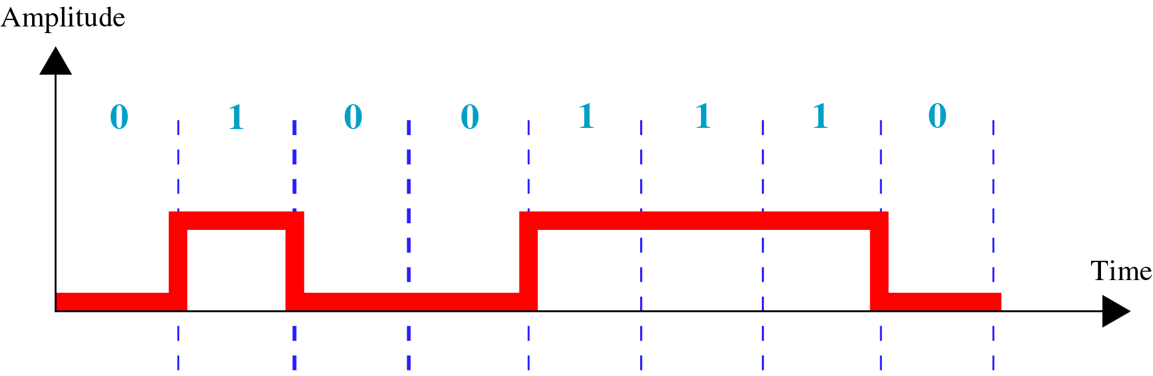
Unipolar Encoding

Slide 12
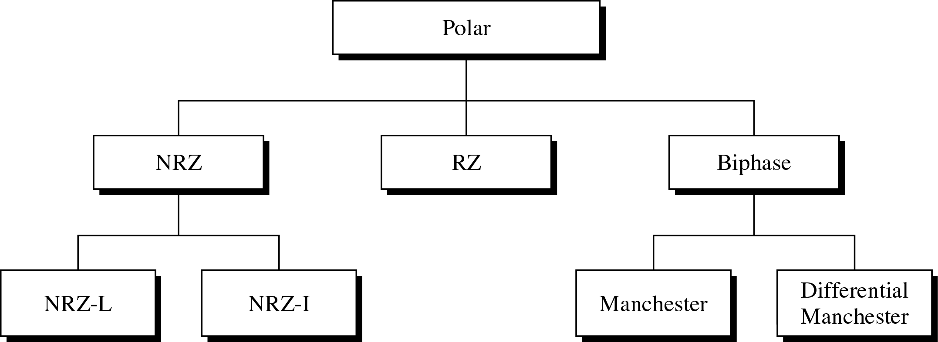
Types of Polar Encoding

Slide 13
Polar - NRZ
The voltages are on both sides of the time axis.
Polar NRZ scheme can be implemented with two voltages. E.g. +V for 0 and -V for 1.
There are two versions:
NZR - Level (NRZ-L) - positive voltage for one symbol and negative for the other
NRZ - Inversion (NRZ-I) - the change or lack of change in polarity determines the value of a symbol. E.g. a “1” symbol inverts the polarity a “0” does not.

Slide 14
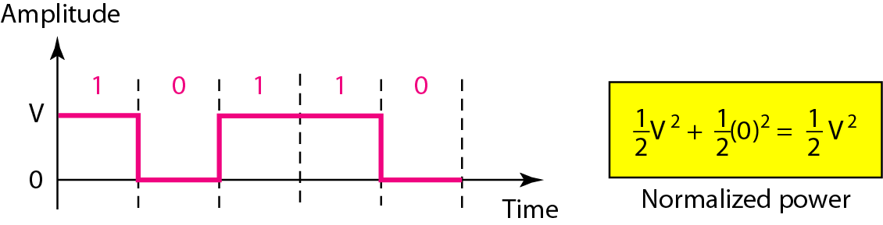
Unipolar NRZ scheme

Slide 15
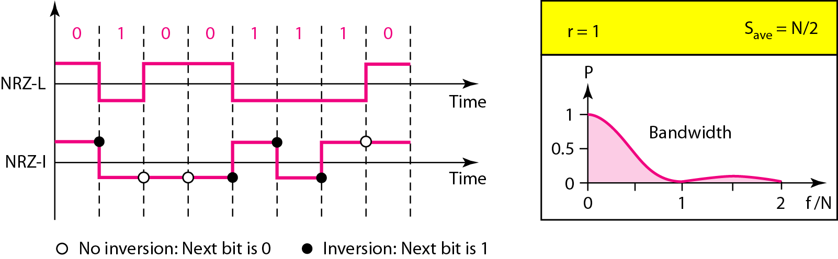
Polar NRZ-L and NRZ-I schemes

Slide 16
Example
A system is using NRZ-I to transfer 10-Mbps data. What are the average signal rate and minimum bandwidth?
Solution
The average signal rate is S= N / 2 = 500 kbaud. The minimum bandwidth for this average baud rate is Bmin = S = 500 kHz.
Note c = 1/2 for the avg. case as worst case is 1 and best case is 0

Slide 17
Polar - RZ
The Return to Zero (RZ) scheme uses three voltage values. +, 0, -.
Each symbol has a transition in the middle. Either from high to zero or from low to zero.
This scheme has more signal transitions (two per symbol) and therefore requires a wider bandwidth.
No DC components or baseline wandering.
Not synchronized.
More complex as it uses three voltage level. It has no error detection capability.

Slide 18
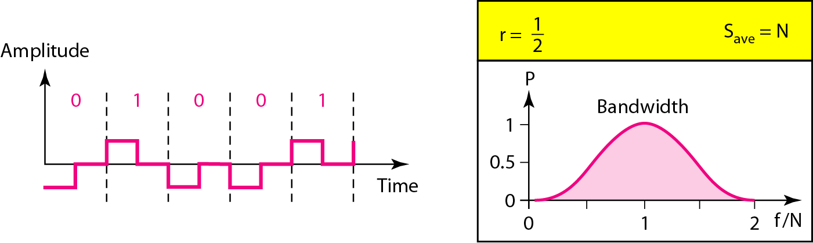
Polar RZ scheme

Slide 19
Polar - Biphase: Manchester and Differential Manchester
Manchester coding consists of combining the NRZ-L and RZ schemes.
Every symbol has a level transition in the middle: from high to low or low to high. Uses only two voltage levels.
Differential Manchester coding consists of combining the NRZ-I and RZ schemes.
Every symbol has a level transition in the middle. But the level at the beginning of the symbol is determined by the symbol value. One symbol causes a level change the other does not.

Slide 20
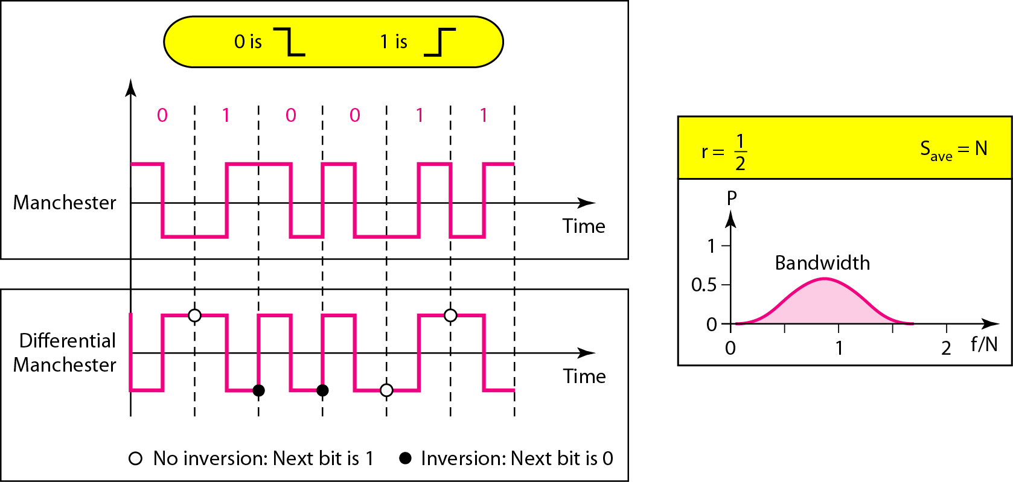
Polar biphase: Manchester and differential Manchester schemes

Slide 21
Bipolar schemes
In this scheme there are three voltage levels positive, negative, and zero. The voltage level for one data element is at zero, while the voltage level for the other element alternates between positive and negative.
Types of bipolar schemes
Bipolar NRZ
Bipolar RZ

Slide 22
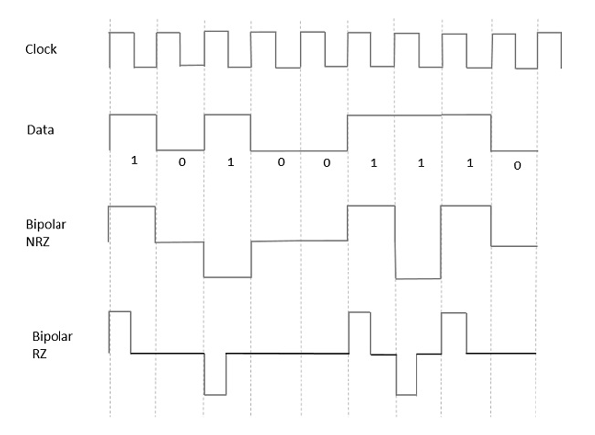
Bipolar Schemes
Bipolar NRZ
This scheme has the same signal rate as NRZ, but there is no DC component as one bit is represented by voltage zero and other alternates every time.
Bipolar RZ

Slide 23
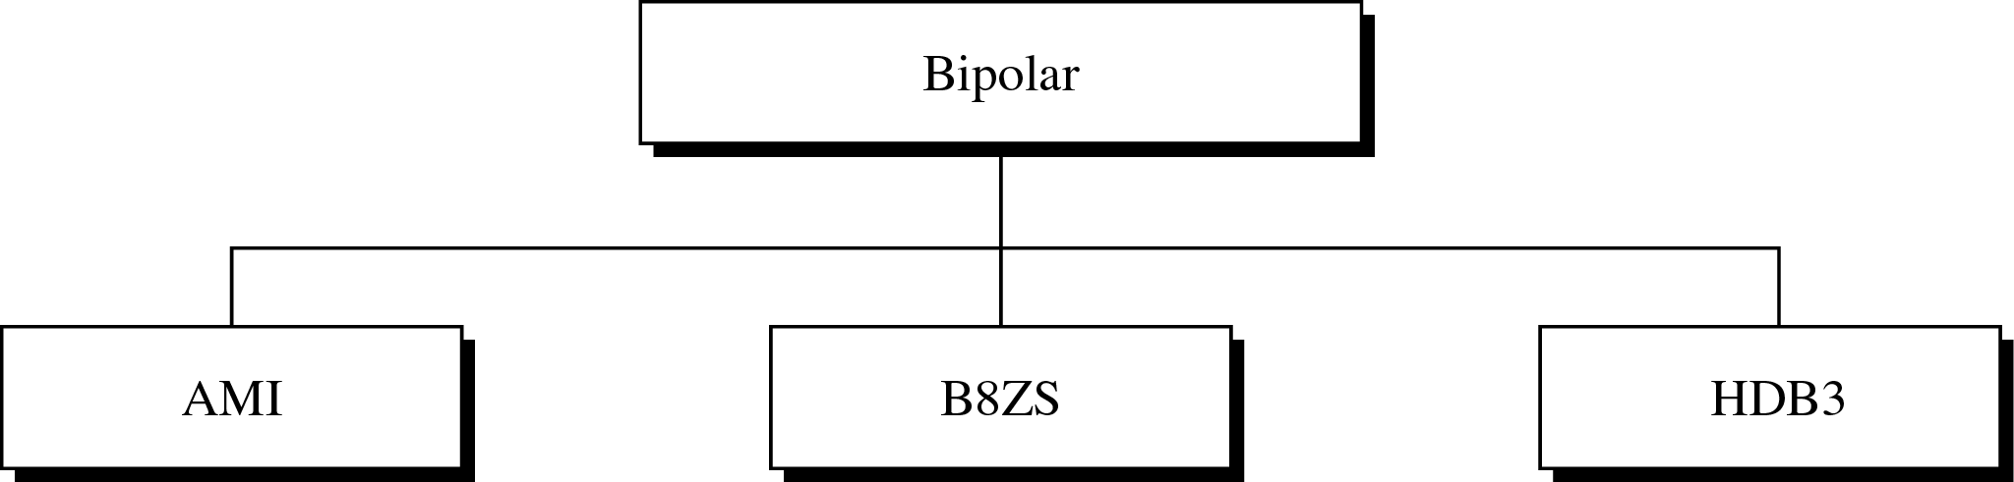
Types of Bipolar Encoding

Slide 24
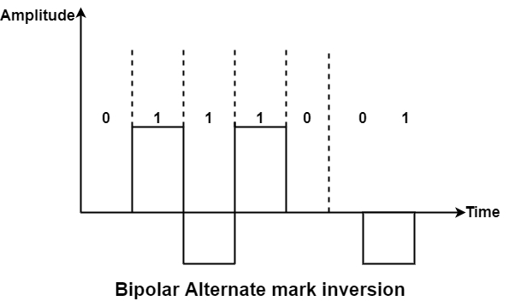
Amplitude Mark Inversion
AMI defines alternate 1 inversion.
In the Bipolar AMI encoding scheme, 0 bit is defined by zero levels and 1 bit is described by rotating positive and negative voltages.
A variation of bipolar AMI is also known as pseudo ternary because binary 0 alternates between +ve and –ve voltages. By reversing each appearance of a 1, bipolar AMI achieves two things, the DC component is zero, and the second stay synchronized. Still, long strings of the synchronization method are not ensured.

Slide 25
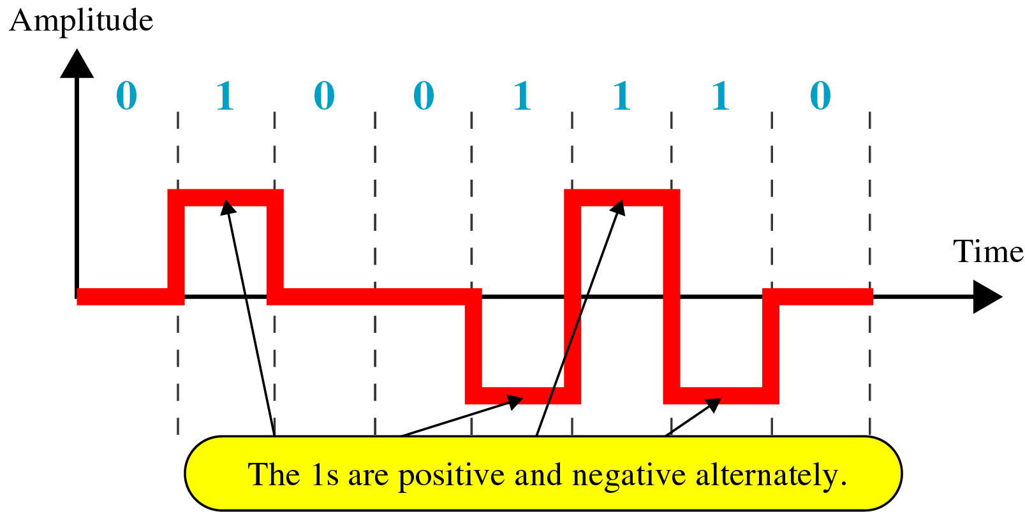
Bipolar AMI Encoding

Slide 26
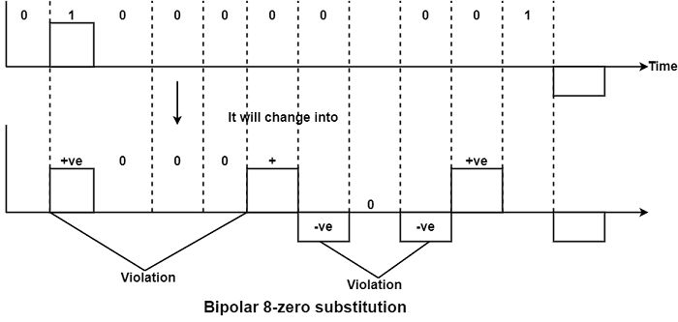
B8ZS-Bipolar 8-Zero Substitution
This is identical to bipolar AMI. Bipolar AMI changes poles with each '1' it encounters. But the signal does not modify during a string of 0’s. So, where synchronization is minimum in AMI.
Eight or more consecutive 0’s are encountered in the DataStream, the design depends on the polarity of the previous 1 is the same (that is occurring just before 8 0’s)

Slide 27
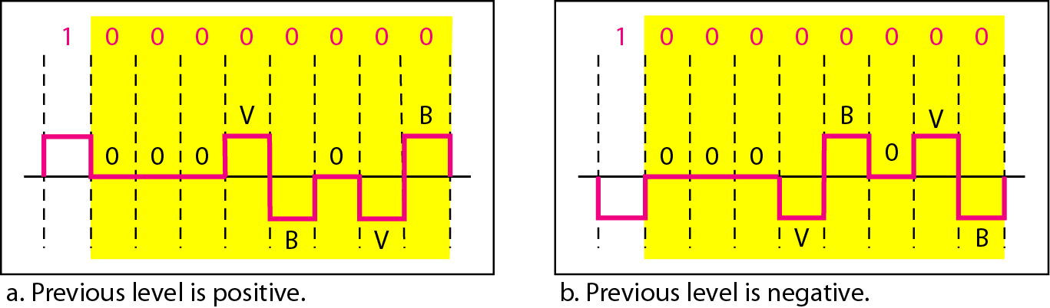
Two cases of B8ZS scrambling technique

Slide 28
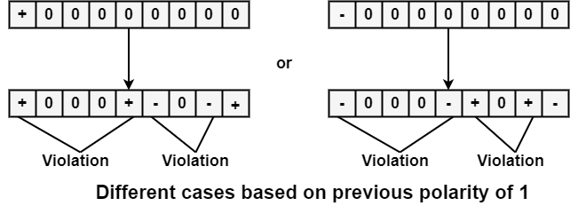
HDB3(High-Density Bipolar)
In blank of (8) zero’s, there are two cases either the polarity of 1 before zero is +ve or
–ve then the solution of both cases will be as
follows

Slide 29
ANALOG TO DIGITAL CONVERSION

Slide 30
ANALOG-TO-DIGITAL CONVERSION
A digital signal is superior to an analog signal because it is more robust to noise and can easily be recovered, corrected and amplified. For this reason, the tendency today is to change an analog signal to digital data. In this section we describe two techniques, pulse code modulation and delta modulation.
Topics discussed in this section:
Pulse Code Modulation (PCM)
Delta Modulation (DM)

Slide 31
PCM- Pulse Code Modulation
PCM consists of three steps to digitize an analog signal:
Sampling
Quantization
Binary encoding
Before we sample, we have to filter the signal to limit the maximum frequency of the signal as it affects the sampling rate.
Filtering should ensure that we do not distort the signal, i.e. remove high frequency components that affect the signal shape.

Slide 32
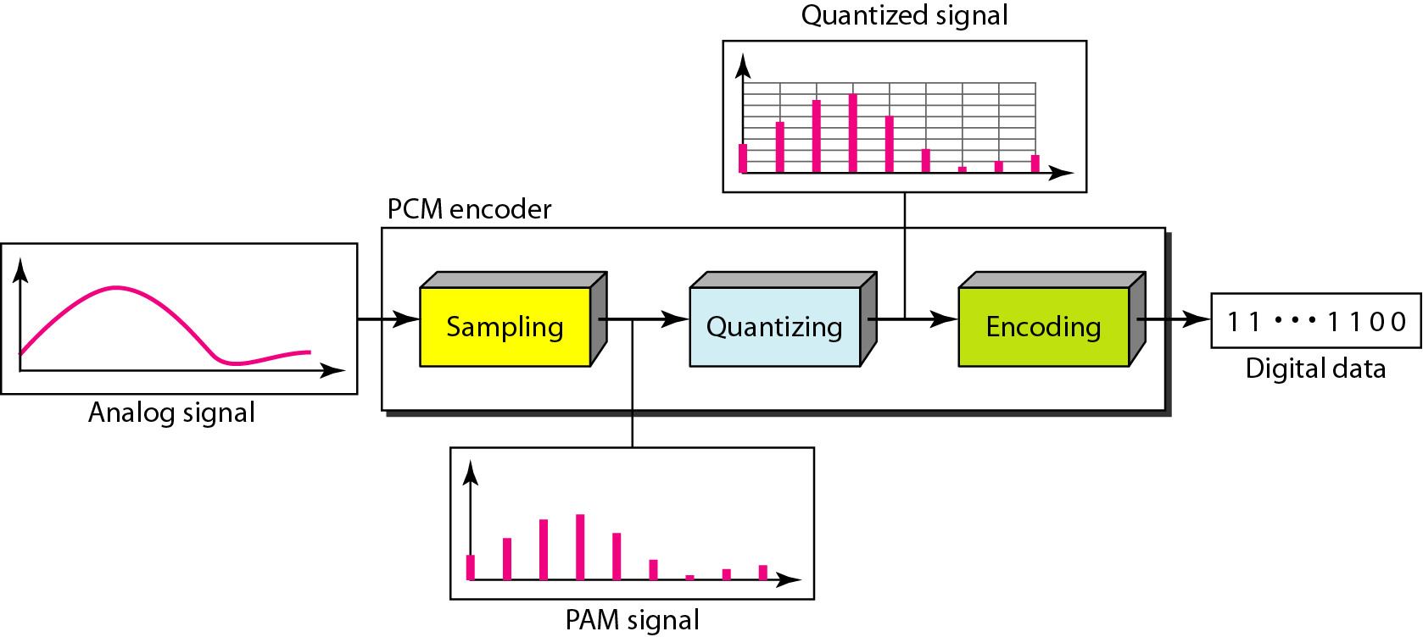
Components of PCM encoder

Slide 33
Sampling
Analog signal is sampled every T_{S} secs.
T_{s} is referred to as the sampling interval.
f_{s} = 1/T_{s} is called the sampling rate or sampling frequency.
There are 3 sampling methods:
Ideal - an impulse at each sampling instant
Natural - a pulse of short width with varying amplitude
Flattop - sample and hold, like natural but with single amplitude value
The process is referred to as pulse amplitude modulation PAM and the outcome is a signal with analog (non integer) values

Slide 34
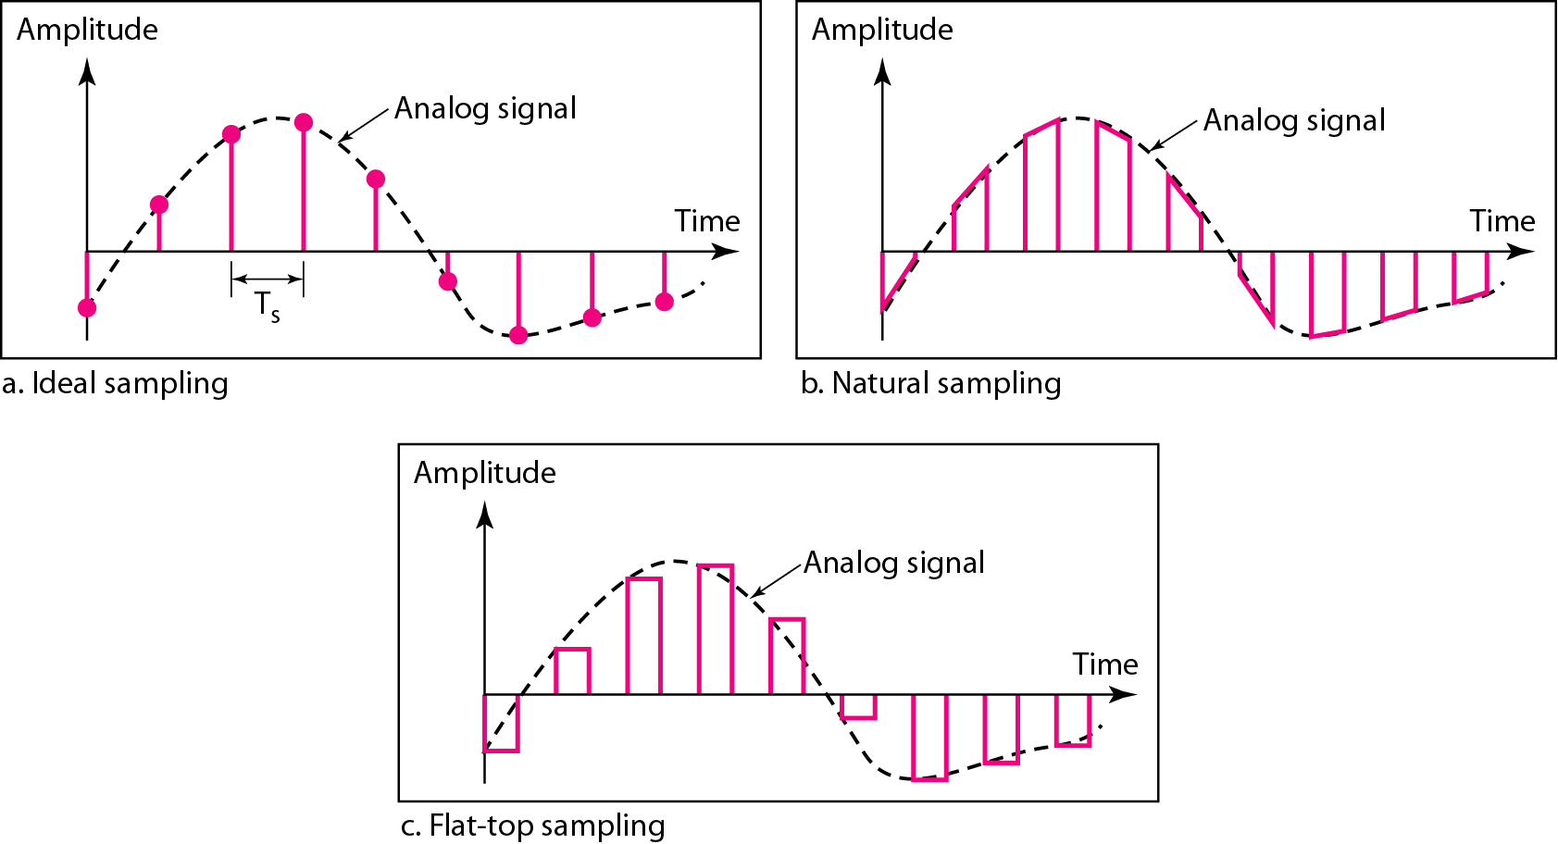
Three different sampling methods for PCM

Slide 35
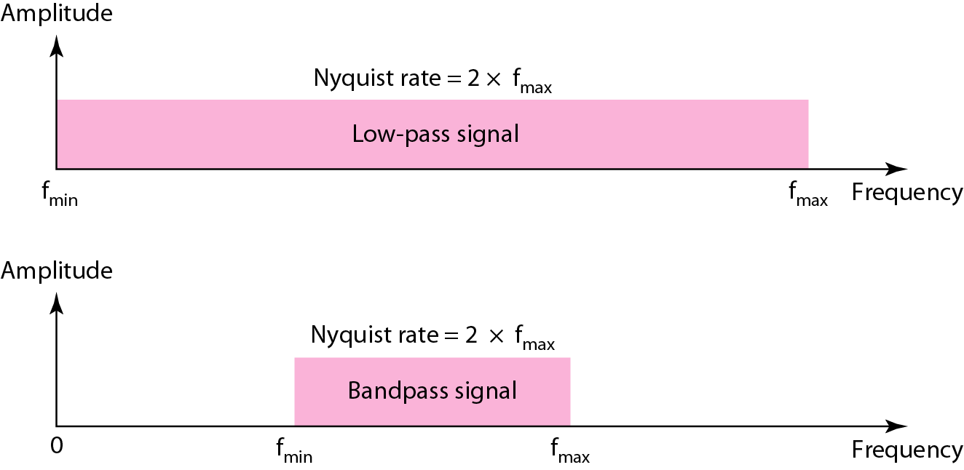
Nyquist sampling rate for low-pass and bandpass signals

Slide 36
Example 1
For an intuitive example of the Nyquist theorem, let us sample a simple sine wave at three sampling rates: f_{s} = 4f (2 times the Nyquist rate), f_{s} = 2f (Nyquist rate), and f_{s} = f (one-half the Nyquist rate). Figure 4.24 shows the sampling and the subsequent recovery of the signal.
It can be seen that sampling at the Nyquist rate can create a good approximation of the original sine wave (part a). Oversampling in part b can also create the same approximation, but it is redundant and unnecessary. Sampling below the Nyquist rate (part c) does not produce a signal that looks like the original sine wave.

Slide 37
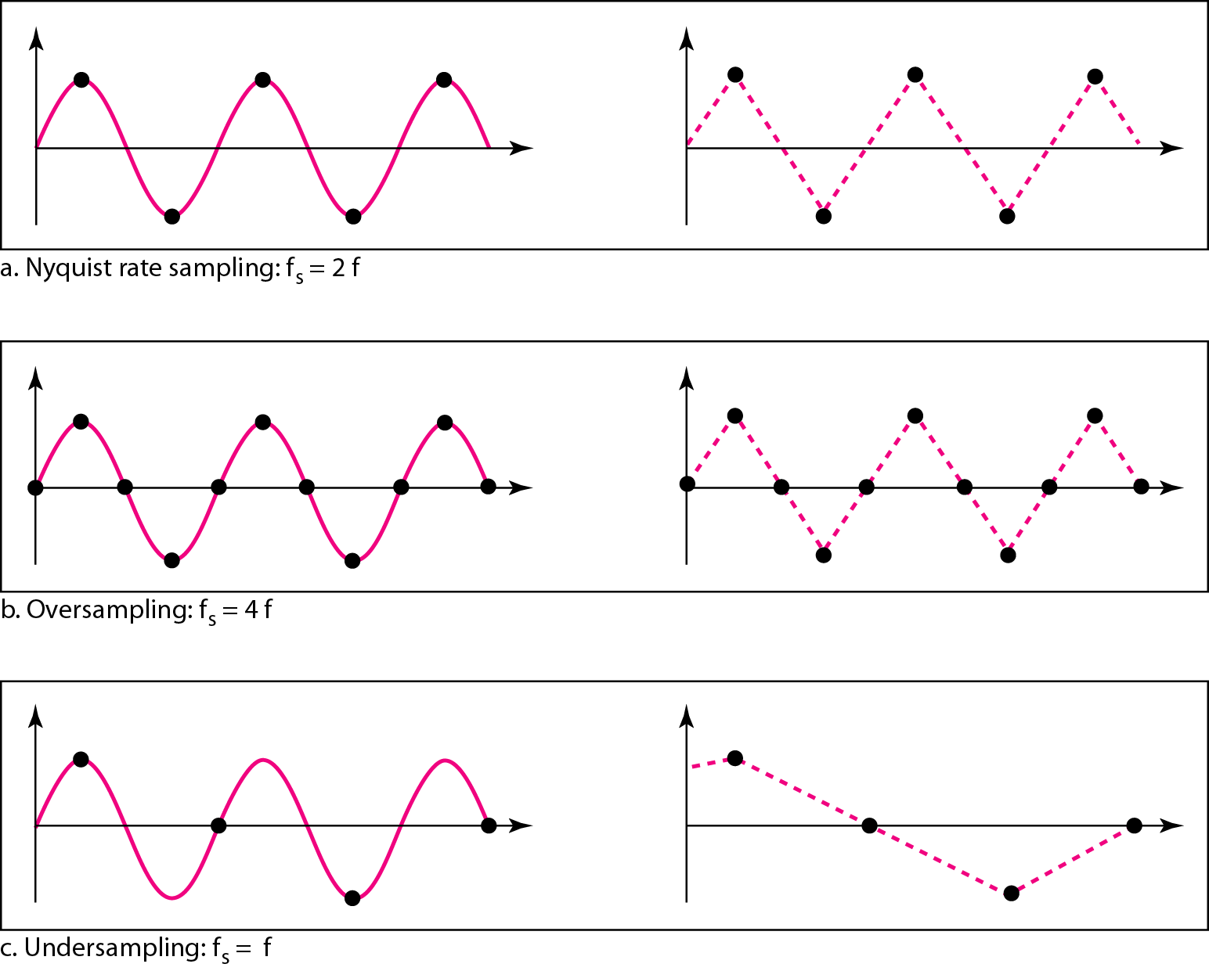
Recovery of a sampled sine wave for different sampling rates

Slide 38
Quantization
Sampling results in a series of pulses of varying amplitude values ranging between two limits: a min and a max.
The amplitude values are infinite between the two limits.
We need to map the infinite amplitude values onto a finite set of known values.
This is achieved by dividing the distance between min and max into L zones, each of height Δ.
Δ = (max - min)/L

Slide 39
Quantization Levels
The midpoint of each zone is assigned a value from 0 to L-1 (resulting in L values)
Each sample falling in a zone is then approximated to the value of the midpoint

Slide 40
Quantization Zones
Assume we have a voltage signal with amplitudes V_{min}=-20V and V_{max}=+20V.
We want to use L=8 quantization levels.
Zone width Δ = (20 - -20)/8 = 5
The 8 zones are: -20 to -15, -15 to -10, -10 to -5, -5 to 0, 0 to +5, +5 to +10, +10 to +15, +15 to +20
The midpoints are: -17.5, -12.5, -7.5, -2.5, 2.5, 7.5, 12.5, 17.5

Slide 41
Assigning Codes to Zones
Each zone is then assigned a binary code.
The number of bits required to encode the zones, or the number of bits per sample as it is commonly referred to, is obtained as follows:
n_{b} = log₂ L
Given our example, n_{b} = 3
The 8 zone (or level) codes are therefore: 000, 001, 010, 011, 100, 101, 110, and 111
Assigning codes to zones:
000 will refer to zone -20 to -15
001 to zone -15 to -10, etc.

Slide 42
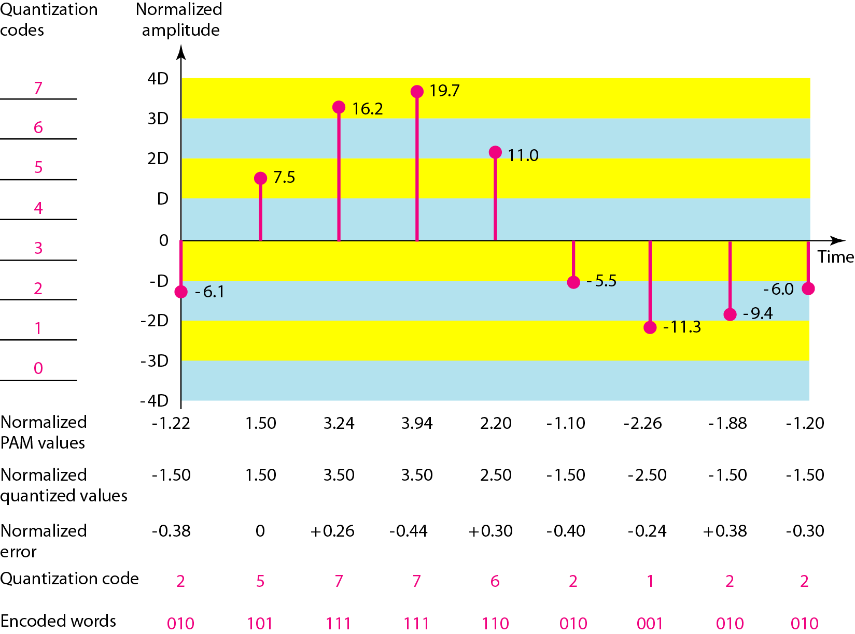
Quantization and encoding of a sampled signal

Slide 43
Quantization Error
When a signal is quantized, we introduce an error - the coded signal is an approximation of the actual amplitude value.
The difference between actual and coded value (midpoint) is referred to as the quantization error.
The more zones, the smaller Δ which results in smaller errors.
BUT, the more zones the more bits required to encode the samples -> higher bit rate

Slide 44
Quantization Error and SN_{Q}R
Signals with lower amplitude values will suffer more from quantization error as the error range: Δ/2, is fixed for all signal levels.
Non linear quantization is used to alleviate this problem. Goal is to keep SN_{Q}R fixed for all sample values.
Two approaches:
The quantization levels follow a logarithmic curve. Smaller Δ’s at lower amplitudes and larger Δ’s at higher amplitudes.
Companding: The sample values are compressed at the sender into logarithmic zones, and then expanded at the receiver. The zones are fixed in height.

Slide 45
PCM Decoder
To recover an analog signal from a digitized signal we follow the following steps:
We use a hold circuit that holds the amplitude value of a pulse till the next pulse arrives.
We pass this signal through a low pass filter with a cutoff frequency that is equal to the highest frequency in the pre-sampled signal.
The higher the value of L, the less distorted a signal is recovered.

Slide 46
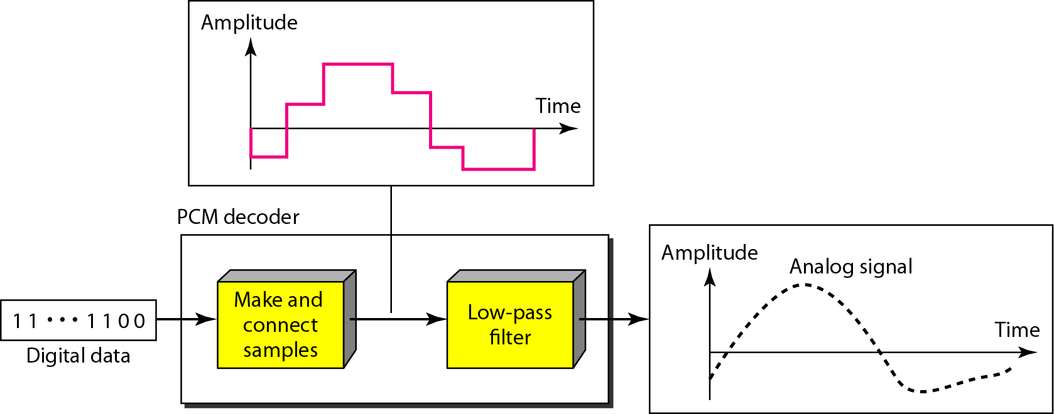
Components of a PCM decoder

Slide 47
Delta Modulation
This scheme sends only the difference between pulses, if the pulse at time t_{n+1} is higher in amplitude value than the pulse at time t_{n}, then a single bit, say a “1”, is used to indicate the positive value.
If the pulse is lower in value, resulting in a negative value, a “0” is used.
This scheme works well for small changes in signal values between samples.
If changes in amplitude are large, this will result in large errors.

Slide 48
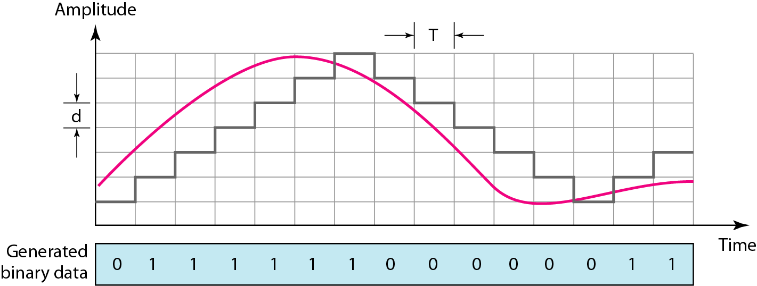
The process of delta modulation

Slide 49
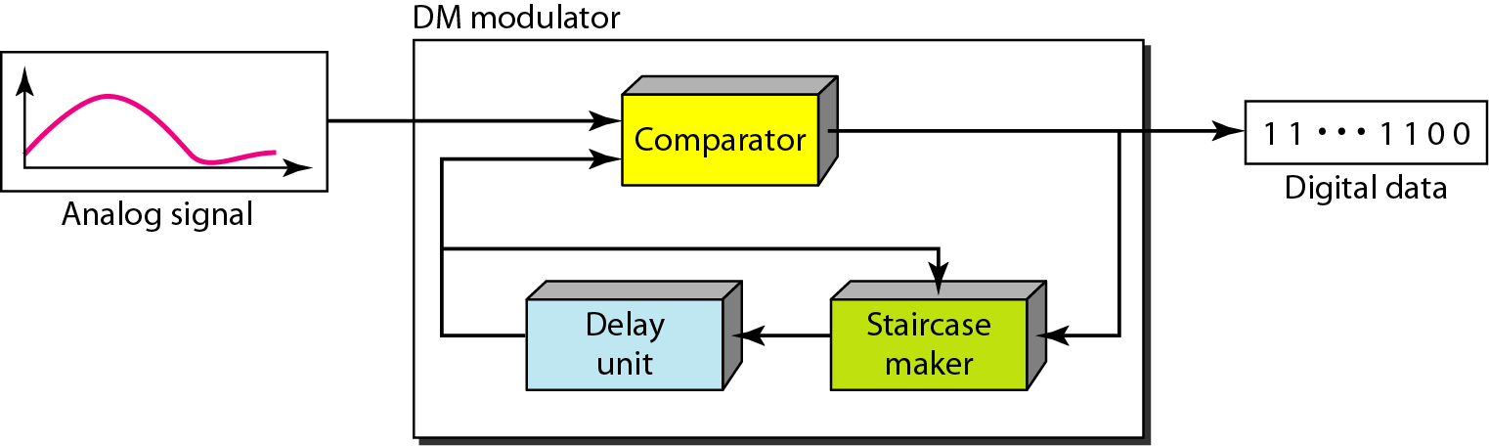
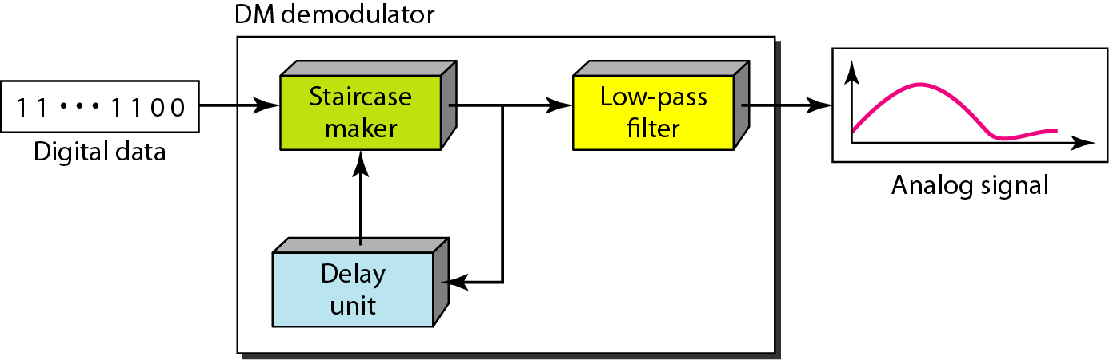
Delta modulation components
Delta demodulation components

Slide 50
Delta PCM (DPCM)
Instead of using one bit to indicate positive and negative differences, we can use more bits -> quantization of the difference.
Each bit code is used to represent the value of the difference.
The more bits the more levels -> the higher the accuracy.

Slide 51
DIGITAL-TO-ANALOG CONVERSION

Slide 52
Digital to Analog Conversion
Converting digital data to a bandpass analog signal is traditionally called digital to- analog conversion
Digital-to-analog conversion is the process of changing one of the characteristics of an analog signal based on the information in digital data.
Digital data needs to be carried on an analog signal.
A carrier signal (frequency f_{c}) performs the function of transporting the digital data in an analog waveform.
The analog carrier signal is manipulated to uniquely identify the digital data being carried.

Slide 53
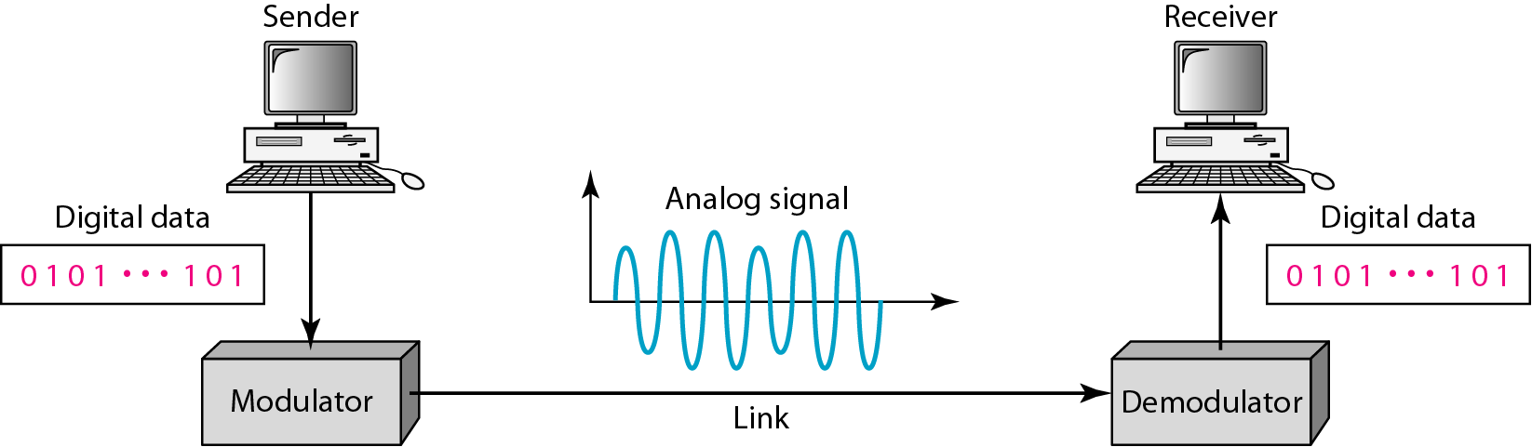
Digital-to-analog conversion
Figure 1 shows the relationship between the digital information, the digital-to-analog modulating process, and the resultant analog signal.

Slide 54
Types of digital-to-analog conversion
Four mechanisms are used for modulating digital data into an analog signal
Amplitude shift keying (ASK)
Frequency shift keying (FSK)
Phase shift keying(PSK)
Quadrature amplitude modulation (QAM – combines ASK &PSK)
QAM is the most efficient and commonly used today

Slide 55
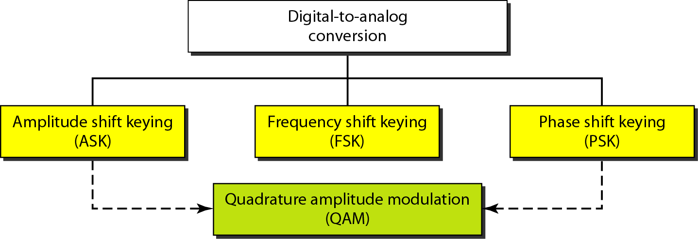
Types of digital-to-analog conversion

Slide 56
Bit and Baud rates and the carrier signal
Bit rate, N, is the number of bits per second (bps). Also called as Data Rate
Baud rate, S is the number of signal elements per second (bauds). Also called as Signal Rate

Slide 57
Cond..
The relationship between them is
S=Nx1/r bauds
Where
S - Signal rate
N - data rate
r - number of data bits per signal element.
In the analog transmission of digital data, the signal or baud rate is less than or equal to the bit rate.

Slide 58
Bit Rate and Baud Rate

Slide 59
Bit Rate and Baud Rate - Continued

Slide 60
Example 1
An analog signal carries 4 bits per signal element. If 1000 signal elements are sent per second, find the bit rate.
Solution
In this case, r = 4, S = 1000, and N is unknown. We can find the value of N from

Slide 61
Example 2
An analog signal has a bit rate of 8000 bps and a baud rate of 1000 baud. How many data elements are carried by each signal element? How many signal elements do we need?
Solution
In this example, S = 1000, N =8000, and rand L are unknown. We find first the value of rand then the value of L.

Slide 62
Amplitude Shift Keying (ASK)
In ASK, the amplitude of the carrier signal is varied to create signal elements. Both frequency and phase remain constant while the amplitude changes.
ASK is implemented by changing the amplitude of a carrier signal to reflect amplitude levels in the digital signal.
For example: a digital “1” could not affect the signal, whereas a digital “0” would, by making it zero.
The line encoding will determine the values of the analog waveform to reflect the digital data being carried.

Slide 63
ASK

Slide 64
Bandwidth of ASK
The bandwidth B of ASK is proportional to the signal rate S.
B = (1+d)S
“d” is depends on modulation and filtering process
“d” value lies between 0 and 1.

Slide 65
Binary ASK (BASK)
ASK is normally implemented using only two levels.
This is referred to as binary amplitude shift keying or on-off keying (OOK).
The peak amplitude of one signal level is 0
the other is the same as the amplitude of the carrier frequency

Slide 66
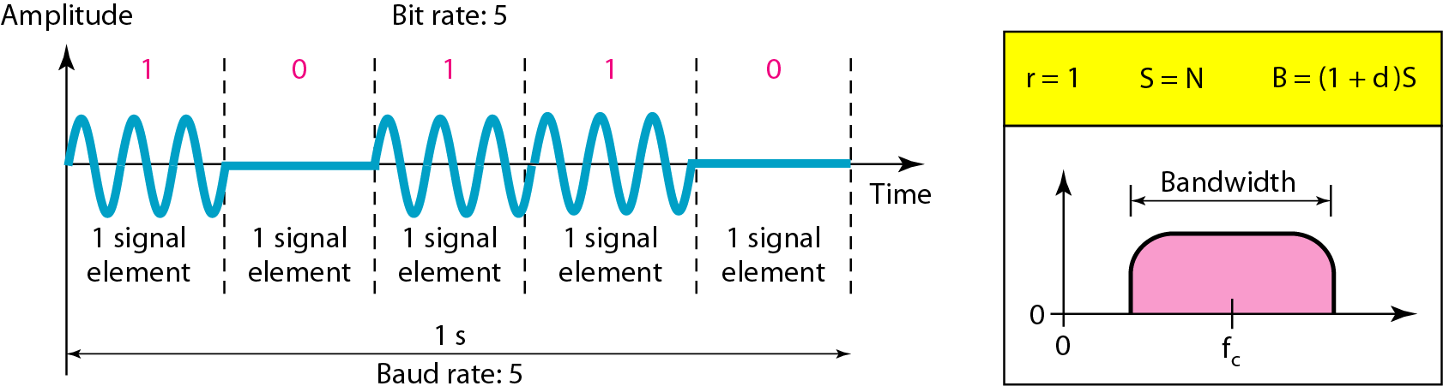
Binary amplitude shift keying

Slide 67
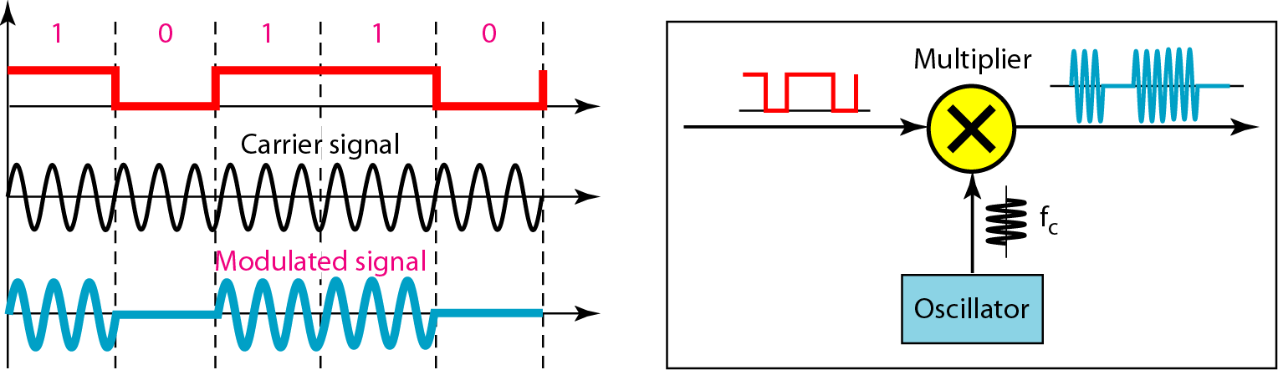
Implementation of binary ASK

Slide 68
If digital data are presented as a unipolar NRZ digital signal with a high voltage of I V and a low voltage of 0 V
Implementation can achieved by multiplying the NRZ digital signal by the carrier signal coming from an oscillator.
When the amplitude of the NRZ signal is 1, the amplitude of the carrier frequency is held;
when the amplitude of the NRZ signal is 0, the amplitude of the carrier frequency is zero.

Slide 69
Example
We have an available bandwidth of 100 kHz which spans from 200 to 300 kHz. What are the carrier frequency and the bit rate if we modulated our data by using ASK with d =I?
Solution:
The middle of the bandwidth is located at 250 kHz. This means that our carrier frequency can be at fe =250 kHz. We can use the formula for bandwidth to find the bit rate (with d =1 and r =1).

Slide 70
Frequency Shift Keying
In frequency shift keying, the frequency of the carrier signal is varied to represent data.
The frequency of the modulated signal is constant for the duration of one signal element, but changes for the next signal element if the data element changes.
Both peak amplitude and phase remain constant for all signal elements.
The digital data stream changes the frequency of the carrier signal, f_{c}.
For example,
a “1” could be represented by f₁=f_{c} +Δf,
a “0” could be represented by f₂=f_{c}-Δf.

Slide 71
FSK

Slide 72
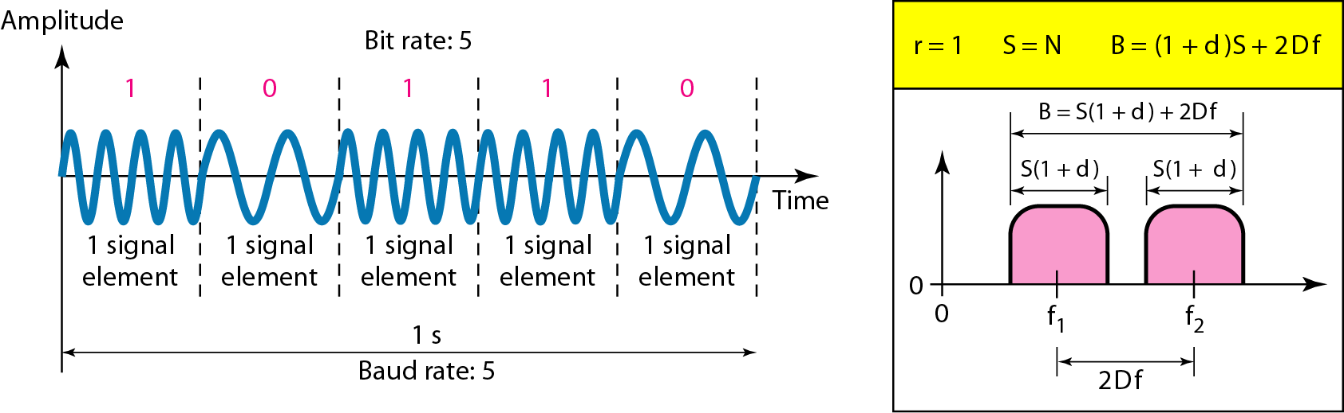
Figure Binary frequency shift keying (BFSK)

Slide 73
Bandwidth of FSK
If the difference between the two frequencies (f₁ and f₂) is 2Δf, then the required BW B will be:
B = (1+d)xS +2Δf

Slide 74
Example
We have an available bandwidth of 100 kHz which spans from 200 to 300 kHz. What should be the carrier frequency and the bit rate if we modulated our data by using FSK with d = 1?
Solution
This problem is similar to Example 5.3, but we are modulating by using FSK. The midpoint of the band is at 250 kHz. We choose 2Δf to be 50 kHz; this means

Slide 75
Phase Shift Keying
In PSK, the phase of the carrier is varied to represent two or more different signal elements. Both peak amplitude and frequency remain constant as the phase changes.
Today, PSK is more common than ASK or FSK
We vary the phase shift of the carrier signal to represent digital data.
The bandwidth requirement, B is:
B = (1+d)xS
PSK is much more robust than ASK as it is not that vulnerable to noise, which changes amplitude of the signal.

Slide 76
PSK

Slide 77
Binary phase shift keying (BPSK)
The simplest PSK is binary PSK, in which we have only two signal elements, one with a phase of 0°, and the other with a phase of 180°.
Binary PSK is as simple as binary ASK
PSK is less susceptible to noise than ASK.
PSK is superior to FSK because we do not need two carrier signals.

Slide 78
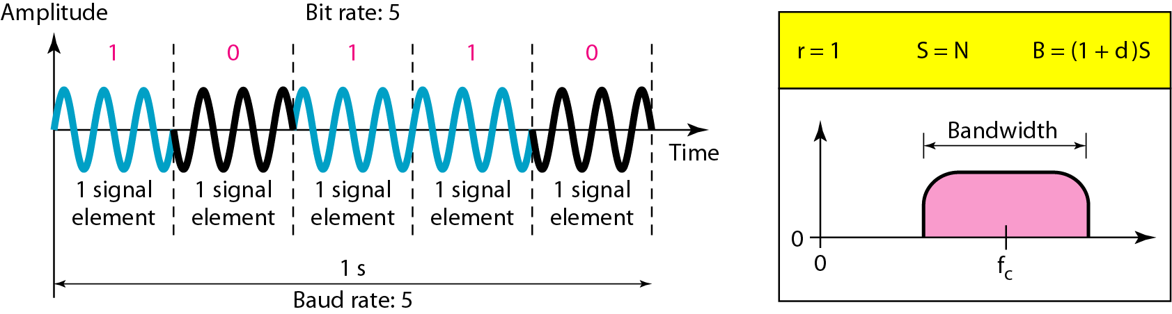
Figure Binary phase shift keying

Slide 79
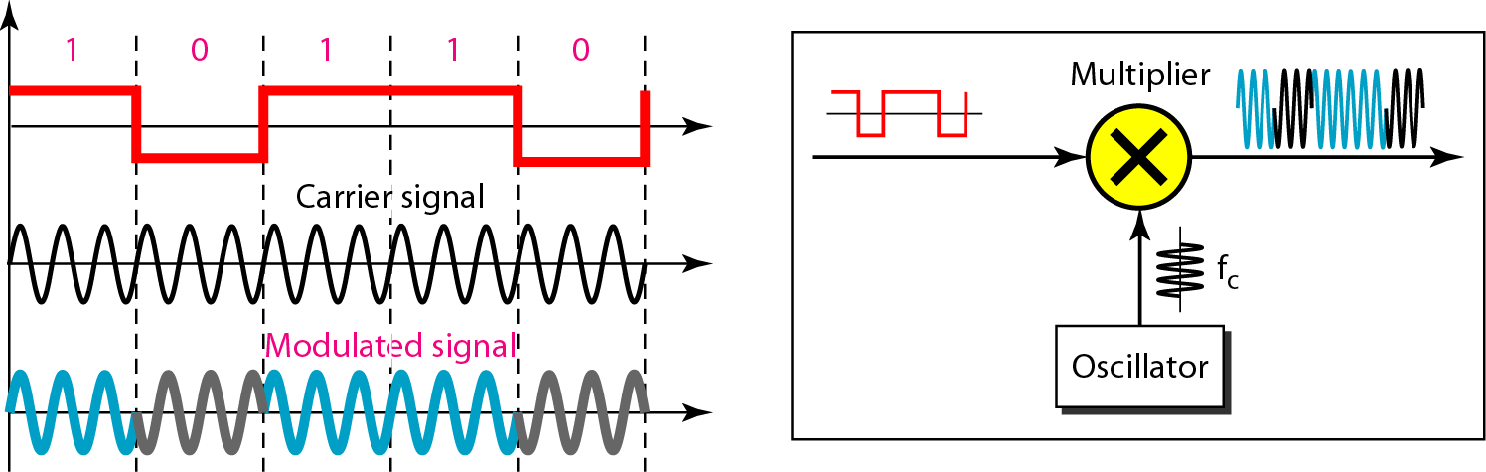
Figure Implementation of BASK

Slide 80
The implementation of BPSK is as simple as that for ASK
The reason is that the signal element with phase 180° can be seen as the complement of the signal element with phase 0°
The polar NRZ signal is multiplied by the carrier frequency;
the 1 bit (positive voltage) is represented by a phase starting at 0°;
the 0 bit (negative voltage) is represented by a phase starting at 180°.

Slide 81
Quadrature PSK
To increase the bit rate, we can code 2 or more bits onto one signal element.
In QPSK, we parallelize the bit stream so that every two incoming bits are split up and PSK a carrier frequency. One carrier frequency is phase shifted 90º from the other - in quadrature.
The two PSKed signals are then added to produce one of 4 signal elements. L = 4 here.

Slide 82
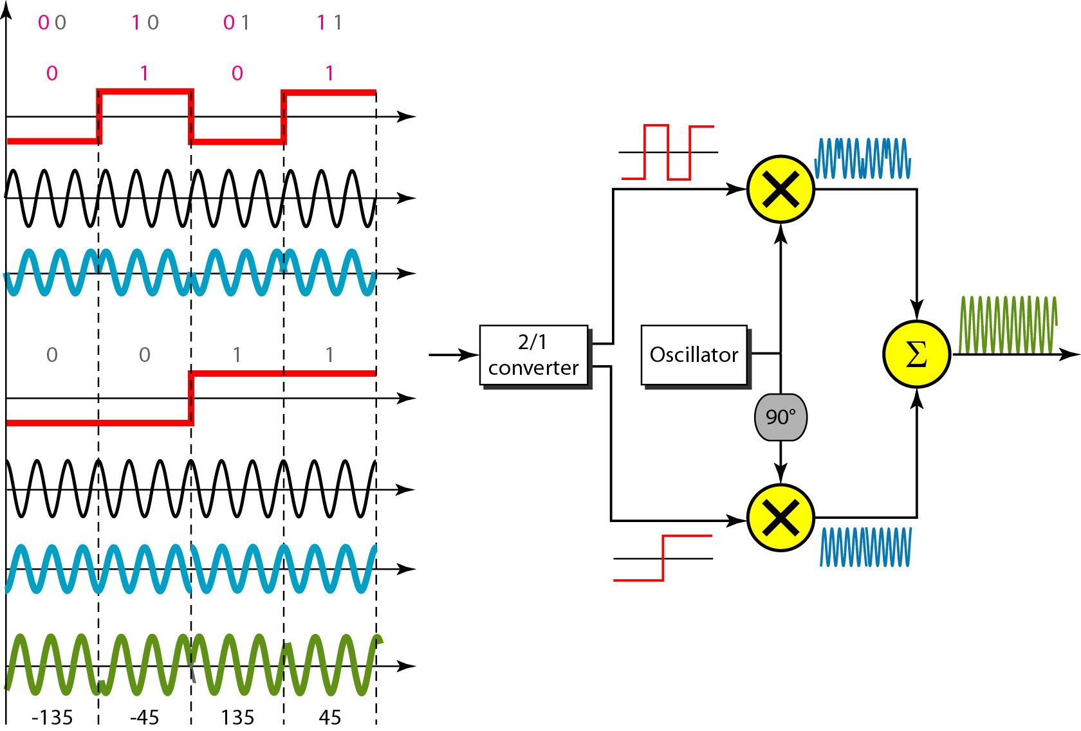
Figure QPSK and its implementation

Slide 83

Example
Find the bandwidth for a signal transmitting at 12 Mbps for QPSK. The value of d = 0.
Solution
For QPSK, 2 bits is carried by one signal element. This means that r = 2. So the signal rate (baud rate) is S = N × (1/r) = 6 Mbaud. With a value of d = 0, we have B = S = 6 MHz.

Slide 84
Constellation Diagrams
A constellation diagram helps us to define the amplitude and phase of a signal when we are using two carriers, one in quadrature of the other.
The X-axis represents the in-phase carrier and the Y-axis represents quadrature carrier.

Slide 85
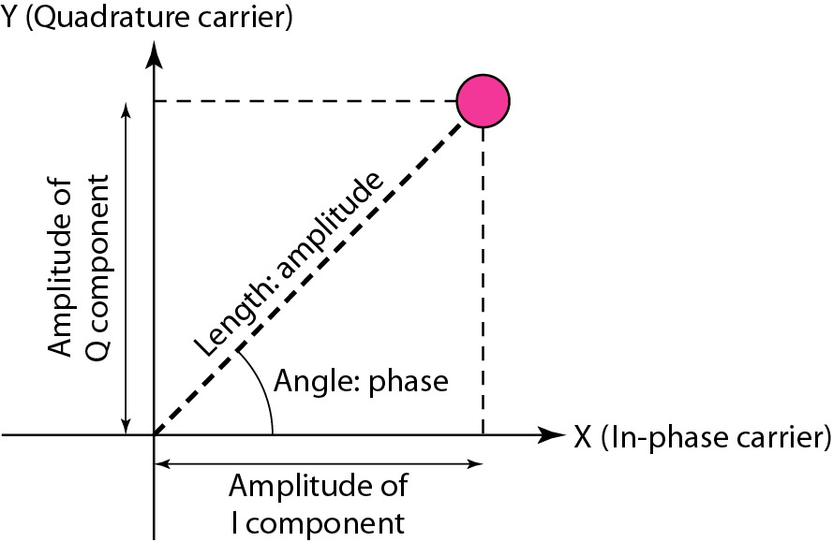
Figure Concept of a constellation diagram

Slide 86
Example
Show the constellation diagrams for an ASK (OOK), BPSK, and QPSK signals.
Solution
Following Figure shows the three constellation diagrams.

Slide 87
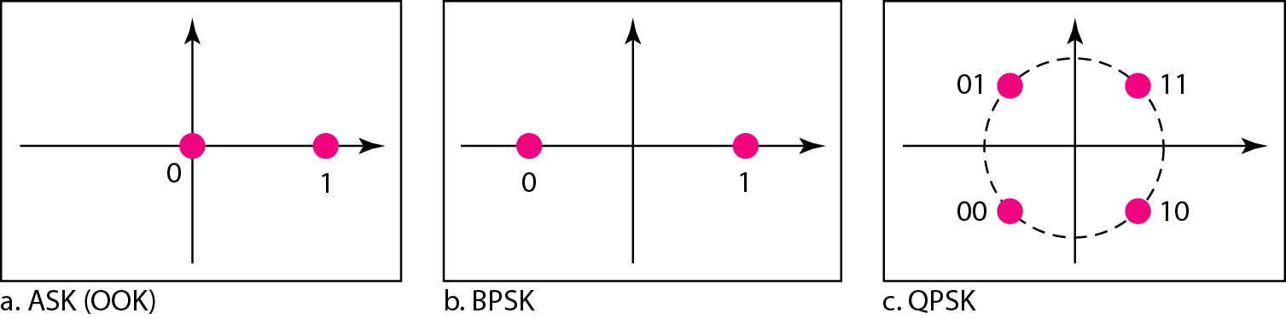
Figure Three constellation diagrams

Slide 88
Quadrature amplitude modulation (QAM) QAM is a combination of ASK and PSK. Bandwidth for QAM The minimum bandwidth required for QAM transmission is the same as that required for ASK and PSK transmission. QAM has the same advantages as PSK over ASK.

Slide 89
4-QAM and 8-QAM
Constellations

Slide 90
Multiplexing : Sharing a Medium

Slide 91
Multiplexing
Multiplexing is a technique used to combine and send the multiple data streams over a single medium. The process of combining the data streams is known as multiplexing and hardware used for multiplexing is known as a multiplexer.
Multiplexing is achieved by using a device called Multiplexer (MUX) that combines n input lines to generate a single output line. Multiplexing follows many-to-one, i.e., n input lines and one output line.
.

Slide 92
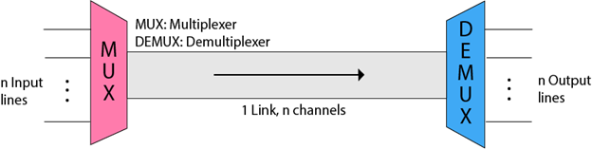
Demultiplexing
Demultiplexing is achieved by using a device called Demultiplexer (DEMUX) available at the receiving end. DEMUX separates a signal into its component signals (one input and n outputs). Therefore, we can say that demultiplexing follows the one-to-many approach.
The 'n' input lines are transmitted through a multiplexer and multiplexer combines the signals to form a composite signal.
The composite signal is passed through a Demultiplexer and demultiplexer separates a signal to component signals and transfers them to their respective destinations

Slide 93
Why Multiplexing?
The transmission medium is used to send the signal from sender to receiver. The medium can only have one signal at a time.
If there are multiple signals to share one medium, then the medium must be divided in such a way that each signal is given some portion of the available bandwidth.
For example: If there are 10 signals and bandwidth of medium is100 units, then the 10 unit is shared by each signal.
When multiple signals share the common medium, there is a possibility of collision. Multiplexing concept is used to avoid such collision.
Transmission services are very expensive.
Advantages of Multiplexing:
More than one signal can be sent over a single medium.
The bandwidth of a medium can be utilized effectively.

Slide 94
Multiplexing Techniques
Frequency division multiplexing (FDM)
Time division multiplexing (TDM)
Wavelength division multiplexing (WDM)
Code division multiplexing (CDM)

Slide 95
Frequency Division Multiplexing
Frequency Division Multiplexing (FDM) is a networking technique in which multiple data signals are combined for simultaneous transmission via a shared communication medium.
FDM uses a carrier signal at a discrete frequency for each data stream and then combines many modulated signals.
When FDM is used to allow multiple users to share a single physical communications medium (i.e. not broadcast through the air), the technology is called frequency-division multiple access (FDMA).

Slide 96
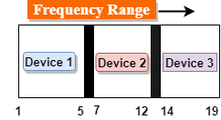
Frequency Division Multiplexing
It is an analog technique.
In the above diagram, a single transmission medium is subdivided into several frequency channels, and each frequency channel is given to different devices.
The input signals are translated into frequency bands by using modulation techniques, and they are combined by a multiplexer to form a composite signal.
The main aim of the FDM is to subdivide the available bandwidth into different frequency channels and allocate them to different devices.
The carriers which are used for modulating the signals are known as sub-carriers. They are represented as f1,f2..fn.

Slide 97
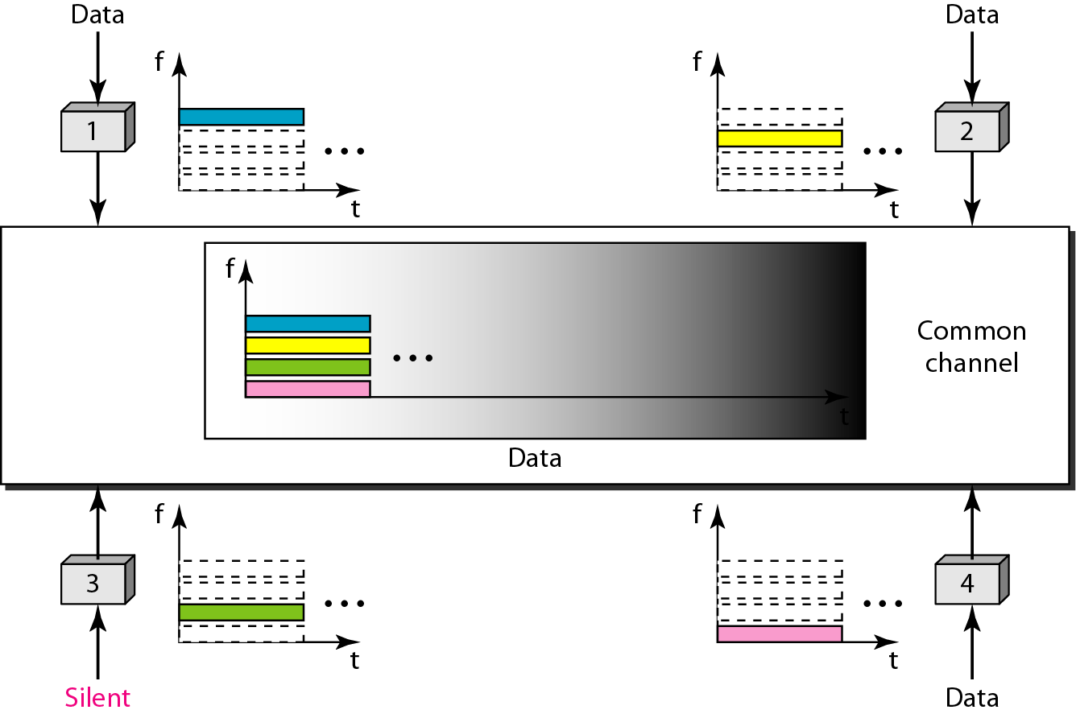
Frequency Division Multiplexing

Slide 98
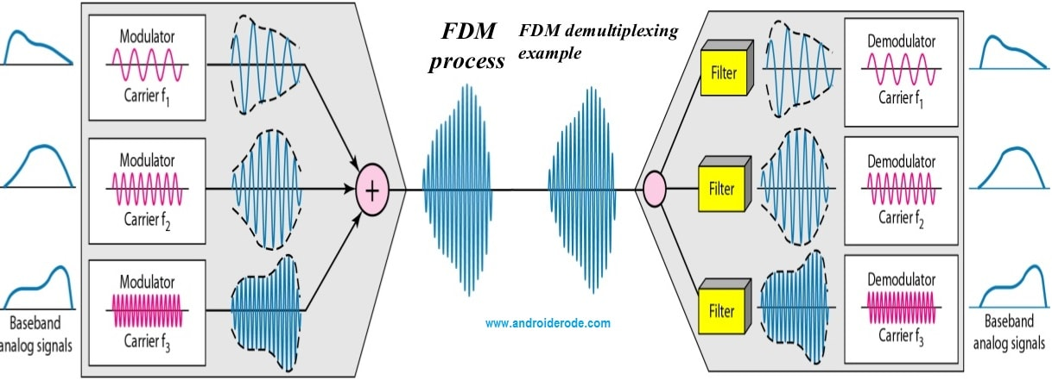
Frequency Division Multiplexing

Slide 99
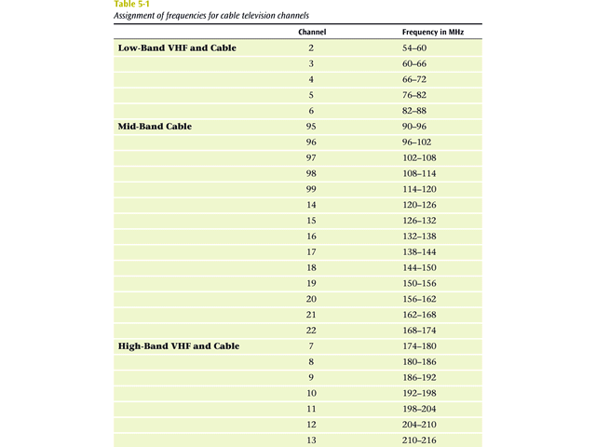
Frequency Division Multiplexing
Analog signaling is used to transmits the signals.
Broadcast radio and television, cable television, and the AMPS cellular phone systems use frequency division multiplexing.
This technique is the oldest multiplexing technique.
Since it involves analog signaling, it is more susceptible to noise.

Slide 100
Advantages Of FDM:
FDM is used for analog signals.
FDM process is very simple and easy modulation.
A Large number of signals can be sent through an FDM simultaneously.
It does not require any synchronization between sender and receiver.
Disadvantages Of FDM:
FDM technique is used only when low-speed channels are required.
It suffers the problem of crosstalk.
A Large number of modulators are required.
It requires a high bandwidth channel.
Applications Of FDM:
FDM is mainly used in radio broadcasts and TV networks.
It is used in FM and AM broadcasting. Each FM radio station has different frequencies, and they are multiplexed to form a composite signal. The multiplexed signal is transmitted in the air.

Slide 101
Time Division Multiplexing
Time-division multiplexing (TDM) is a digital process that allows several connections to share the high bandwidth of a line Instead of sharing a portion of the bandwidth as in FDM, time is shared.
Each connection occupies a portion of time in the link.

Slide 102
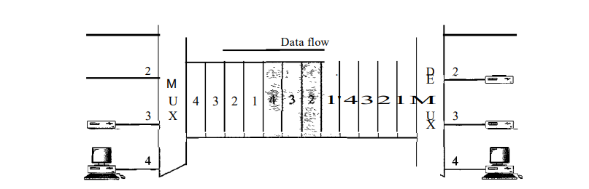
Time Division Multiplexing
Note that the same link is used as in FDM; here, however, the link is shown sectioned by time rather than by frequency. In the figure, portions of signals 1,2,3, and 4 occupy the link sequentially.
Types : synchronous and statistical.

Slide 104
Synchronous Time Division Multiplexing
The original time division multiplexing.
The multiplexor accepts input from attached devices in a round-robin fashion and transmit the data in a never ending pattern.
T-1 and ISDN telephone lines are common examples of synchronous time division multiplexing.

Slide 105
Synchronous TDM
In synchronous TDM, the data flow of each input connection is divided into units, where each input occupies one input time slot.
A unit can be 1 bit, one character, or one block of data. Each input unit becomes one output unit and occupies one output time slot.
However, the duration of an output time slot is n times shorter than the duration of an input time slot. If an input time slot is T s, the output time slot is Tin s, where n is the number of connections.
In other words, a unit in the output connection has a shorter duration; it travels faster.

Slide 106
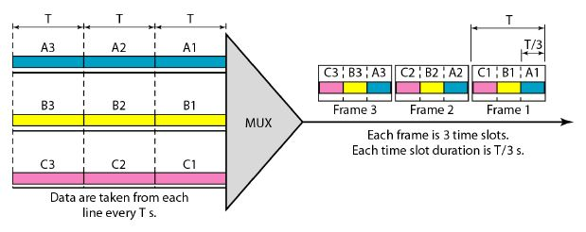
Synchronous TDM
In synchronous TDM, the data rate of the link is n times faster, and the unit duration is n times shorter.

Slide 107
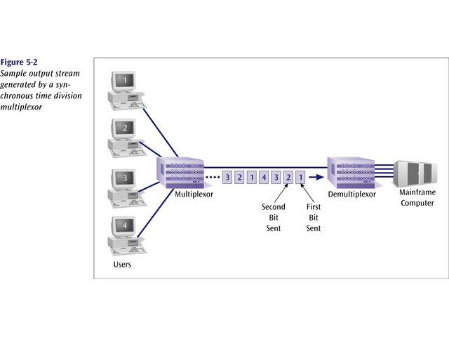
Sample Output Stream generated by a
Synchronous Time Division Multiplexing

Slide 108
Synchronous Time Division Multiplexing
If one device generates data at a faster rate than other devices, then the multiplexor must either sample the incoming data stream from that device more often than it samples the other devices, or buffer the faster incoming stream.
If a device has nothing to transmit, the multiplexor must still insert a piece of data from that device into the multiplexed stream.

Slide 109
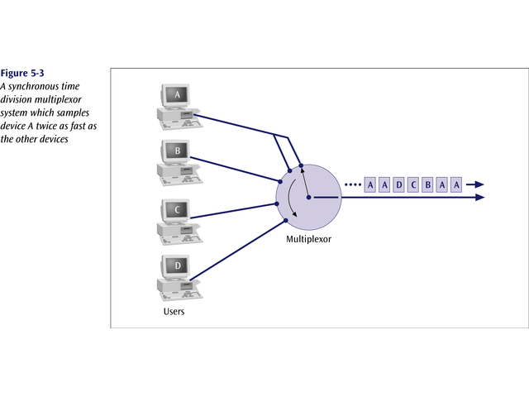
Example

Slide 110
Statistical Time Division Multiplexing
A statistical multiplexor does not require a line over as high a speed line as synchronous time division multiplexing since STDM does not assume all sources will transmit all of the time!
Good for low bandwidth lines (used for LANs)
Much more efficient use of bandwidth!

Slide 111
Statistical Time Division Multiplexing
A statistical multiplexor transmits only the data from active workstations (or why work when you don’t have to).
If a workstation is not active, no space is wasted on the multiplexed stream.
A statistical multiplexor accepts the incoming data streams and creates a frame containing only the data to be transmitted.

Slide 112
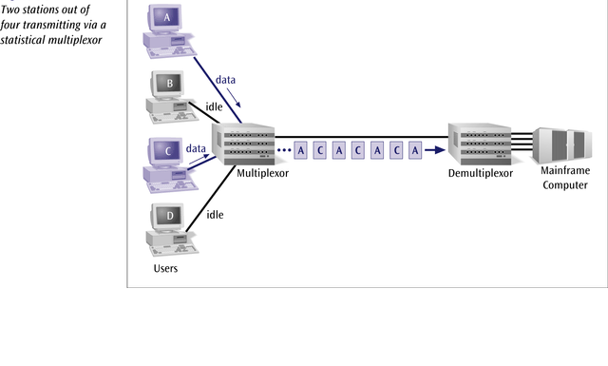

Slide 113
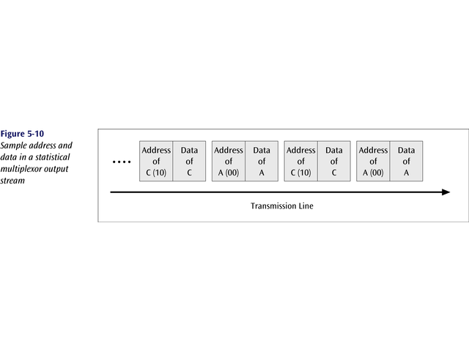
To identify each piece of data, an address is included.

Slide 114
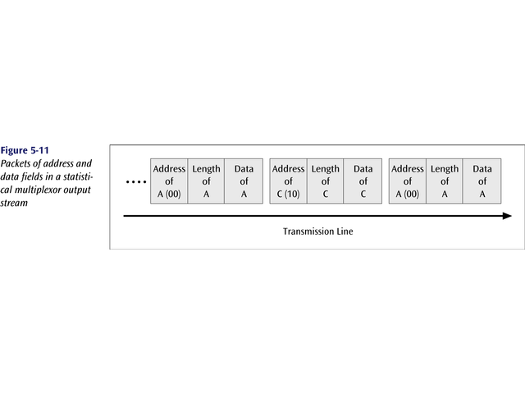
If the data is of variable size, a length is also included.

Slide 115
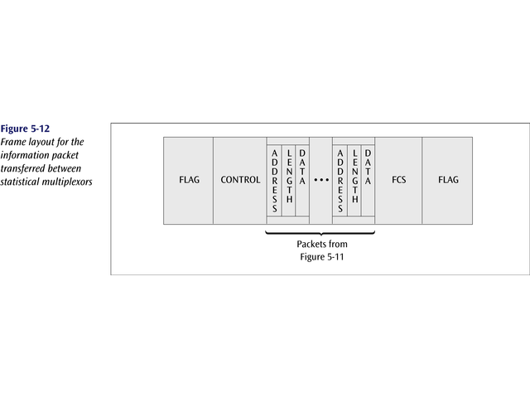
More precisely, the transmitted frame contains a collection of data groups.

Slide 116
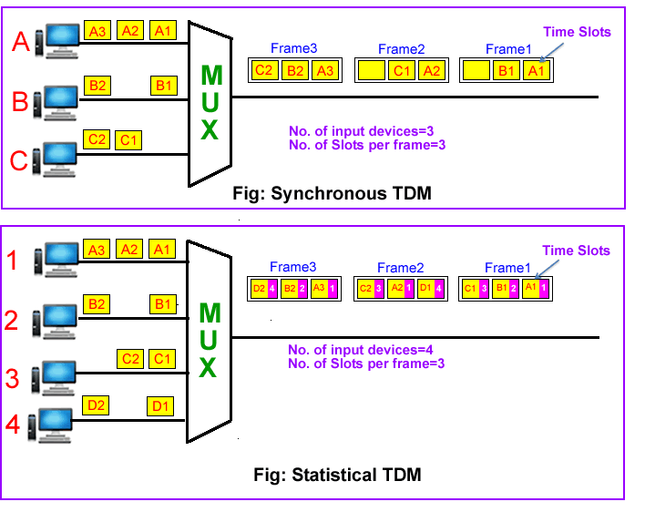

Slide 117

Problems
Synchronous TDM with a data stream for each input and one data stream for the output. The unit of data is 1 bit. Find (a) the input bit duration, (b) the output bit duration, (c) the output bit rate, and (d) the output frame rate.

Slide 118
Solution
A. The input bit duration is the inverse of the bit rate: 1/1 Mbps = 1 lls.
b. The output bit duration is one-fourth of the input bit duration, or 1/411s.
c. The output bit rate is the inverse of the output bit duration or 1/4 lls, or 4 Mbps. This can also be deduced from the fact that the output rate is 4 times as fast as any input rate; so the output rate =4 x 1 Mbps =4 Mbps.
d. The frame rate is always the same as any input rate. So the frame rate is 1,000,000 frames per second. Because we are sending 4 bits in each frame, we can verify the result of the previous question by multiplying the frame rate by the number of bits per frame.

Slide 119

Wavelength Division Multiplexing (WDM)
Give each message a different wavelength (frequency).
Easy to do with fiber optics and optical sources

Slide 120
Categories of WDM
Course WDM (CWDM) : CWDM generally operates with 8 channels where the spacing between the channels is 20 nm (nanometers) apart. It consumes less energy than DWDM and is less expensive. However, the capacity of the links, as well as the distance supported, is lesser.
Dense WDM (DWDM) : In DWDM, the number of multiplexed channels much larger than CWDM. It is either 40 at 100GHz spacing or 80 with 50GHz spacing. Due to this, they can transmit the huge quantity of data through a single fiber link. DWDM is generally applied in core networks of telecommunications and cable networks. It is also used in cloud data centers for their IaaS services.

Slide 121
Dense Wavelength Division
Multiplexing (DWDM)
Dense wavelength division multiplexing is often called just wavelength division multiplexing
Dense wavelength division multiplexing multiplexes multiple data streams onto a single fiber optic line.
Different wavelength lasers (called lambdas) transmit the multiple signals.
Each signal carried on the fiber can be transmitted at a different rate from the other signals.
Dense wavelength division multiplexing combines many (30, 40, 50, 60, more?) onto one fiber.

Slide 122

Data Signals Transmitted

Slide 123


Slide 124
Transmission Media

Slide 125

Transmission Media
The physical path between transmitter and receiver is called transmission medium. It is a pathway that carries information from sender to receiver.
In One type of transmission medium , transmission occurs through a solid medium, such as copper twisted pair, copper coaxial cable, and optical fiber
For second type of transmission medium , transmission occurs wireless through the atmosphere, outer space, or water.
It is located below the physical layer and are directly controlled by the physical layer.
Data is transmitted normally in electrical or electromagnetic signals.
Signals are transmitted in the form of electromagnetic energy.

Slide 126
Transmission medium and physical layer

Slide 127

Classes of transmission media

Slide 128
GUIDED MEDIA
Guided media, which are those that provide a conduit from one device to another, include twisted-pair cable, coaxial cable, and fiber-optic cable.
Topics discussed in this section:
Twisted-Pair Cable Coaxial Cable Fiber-Optic Cable
Twisted-pair and coaxial cable use metallic (copper) conductors that accept and transport signals in the form of electric current.
Optical fiber is a cable that accepts and transports signals in the form of light.

Slide 129
Twisted-pair cable

Slide 130
Twisted-pair cable
A twisted pair consists of two conductors (normally copper), each with its own plastic insulation, twisted together.
One of the wires is used to carry signals to the receiver, and the other is used only as a ground reference.
The receiver uses the difference between the two.
In addition to the signal sent by the sender on one of the wires, interference (noise) and crosstalk may affect both wires and create unwanted signals.

Slide 131
Twisted-pair cable
If the two wires are parallel, the effect of these unwanted signals is not the same in both wires because they are at different locations relative to the noise or crosstalk sources
(e,g., one is closer and the other is farther). This results in a difference at the receiver.
By twisting the pairs, a balance is maintained.
For example, suppose in one twist, one wire is closer to the noise source and the other is farther; in the next twist, the reverse is true.

Slide 132
Twisted-pair cable
Twisting makes it probable that both wires are equally affected by external influences (noise or crosstalk).
This means that the receiver, which calculates the difference between the two, receives no unwanted signals. The unwanted signals are mostly canceled out.
From the above discussion, it is clear that the number of twists per unit of length (e.g., inch) has some effect on the quality of the cable.

Slide 133
Effect of Noise on Parallel Lines

Slide 134
Noise on Twisted-Pair Lines

Slide 135
Unshielded Twisted Pair (UTP)
Ordinary telephone wire
Cheapest
Easiest to install
Suffers from external EM interference
Advantages of UTP:
Affordable
Most compatible cabling
Major networking system
Disadvantages of UTP:
Suffers from external Electromagnetic interference
Applications:
Telephone lines connecting subscribers to the central office
DSL lines
LAN – 10Base-T and 100Base-T

Slide 136

UTP and STP cables

Slide 137
Unshielded Versus Shielded Twisted-Pair Cable
The most common twisted-pair cable used in communications is referred to as unshielded twisted-pair (UTP).
IBM has also produced a version of twisted-pair cable for its use called shielded twisted-pair (STP).
STP cable has a metal foil or braided mesh covering that encases each pair of insulated conductors.
Although metal casing improves the quality of cable by preventing the penetration of noise or crosstalk, it is bulkier and more expensive.
Our discussion focuses primarily on UTP because STP is seldom used outside of IBM.

Slide 138
Performance
One way to measure the performance of twisted-pair cable is to compare attenuation versus frequency and distance.
A twisted-pair cable can pass a wide range of frequencies.
However, the below figure shows that with increasing frequency, the attenuation, measured in decibels per kilometer (dB/km), sharply increases with frequencies above 100 kHz.
Note that gauge is a measure of the thickness of the wire.

Slide 139

UTP performance

Slide 140

UTP connector

Slide 141
Applications
Twisted-pair cables are used in telephone lines to provide voice and data channels.
The local loop-the line that connects subscribers to the central telephone office---commonly consists of unshielded twisted-pair cables.
The DSL lines that are used by the telephone companies to provide high-data-rate connections also use the high-bandwidth capability of unshielded twisted-pair cables.

Slide 142
Coaxial Cable
Coaxial cable (or coax) carries signals of higher frequency ranges than those in twistedpair cable, in part because the two media are constructed quite differently.
Instead of having two wires, coax has a central core conductor of solid or stranded wire (usually copper) enclosed in an insulating sheath, which is, in turn, encased in an outer conductor of metal foil, braid, or a combination of the two.
The outer metallic wrapping serves both as a shield against noise and as the second conductor, which completes the circuit.
This outer conductor is also enclosed in an insulating sheath, and the whole cable is protected by a plastic cover

Slide 143

Coaxial cable

Slide 144

Coaxial Cable Standards
Coaxial cables are categorized by their radio government (RG) ratings.
Each RG number denotes a unique set of physical specifications, including the wire gauge of the inner conductor, the thickness and type of the inner insulator, the construction of the shield, and the size and type of the outer casing.
Each cable defined by an RG rating is adapted for a specialized function, as shown in following Table
Table 7.2 Categories of coaxial cables

Slide 145
Coaxial Cable Connectors
To connect coaxial cable to devices, we need coaxial connectors.
The most common type of connector used today is the Bayone-Neill-Concelman (BNC) connector.
The BNC connector is used to connect the end of the cable to a device, such as a TV set.
The BNC T connector is used in Ethernet networks to branch out to a connection to a computer or other device.
The BNC terminator is used at the end of the cable to prevent the reflection of the signal.

Slide 146

BNC connectors

Slide 147
Applications
Coaxial cable was widely used in analog telephone networks where a single coaxial network could carry 10,000 voice signals.
Later it was used in digital telephone networks where a single coaxial cable could carry digital data up to 600 Mbps.
However, coaxial cable in telephone networks has largely been replaced today with fiber-optic cable.
Cable TV networks also use coaxial cables. In the traditional cable TV network, the entire network used coaxial cable.
Later, however, cable TV providers replaced most of the media with fiber-optic cable;
Hybrid networks use coaxial cable only at the network boundaries, near the consumer premises.
Cable TV uses RG-59 coaxial cable.

Slide 148
Applications
Another common application of coaxial cable is in traditional Ethernet LANs Because of its high bandwidth, and consequently high data rate, coaxial
cable was chosen for digital transmission in early Ethernet LANs.
The 10Base-2, or Thin Ethernet, uses RG-58 coaxial cable with BNC connectors to transmit data at 10 Mbps with a range of 185 m.
The lOBase5, or Thick Ethernet, uses RG-11 (thick coaxial cable) to transmit 10 Mbps with a range of 5000 m.
Thick Ethernet has specialized connectors.

Slide 149
Fiber-Optic Cable
A fiber-optic cable is made of glass or plastic and transmits signals in the form of light.
To understand optical fiber, we first need to explore several aspects of the nature of light.
Light travels in a straight line as long as it is moving through a single uniform substance.
If a ray of light traveling through one substance suddenly enters another substance (of a different density), the ray changes direction.
The following figure shows how a ray of light changes direction when going from a more dense to a less dense substance.

Slide 150

Optical fiber

Slide 151

Fiber optics: Bending of light ray

Slide 152
Fiber-Optic Cable
If the angle of incidence I (the angle the ray makes with the line perpendicular to the interface between the two substances) is less than the critical angle, the ray refracts and moves closer to the surface.
If the angle of incidence is equal to the critical angle, the light bends along the interface.
If the angle is greater than the critical angle, the ray reflects (makes a turn) and travels again in the denser substance.
Note that the critical angle is a property of the substance, and its value differs from one substance to another.
Optical fibers use reflection to guide light through a channel.
A glass or plastic core is surrounded by a cladding of less dense glass or plastic. The difference in density of the two materials must be such that a beam of light moving through the core is reflected off the cladding instead of being refracted into it.

Slide 153

Propagation modes

Slide 154
Multimode – Step index
Multimode is so named because multiple beams from a light source move through the core in different paths. How these beams move within the cable depends on the structure ofthe core, as shown in Figure 7.13.
In multimode step-index fiber, the density of the core remains constant from the center to the edges. A beam of light moves through this constant density in a straight line until it reaches the interface of the core and the cladding. At the interface, there is an abrupt change due to a lower density; this alters the angle of the beam's motion.
The term step index refers to the suddenness of this change, which contributes to the distortion of the signal as it passes through the fiber

Slide 155
Multimode Step-Index

Slide 156
Multimode – Graded Index
A second type of fiber, called multimode graded-index fiber, decreases this distortion of the signal through the cable. The word index here refers to the index of refraction.
As we saw above, the index of refraction is related to density. A graded-index fiber, therefore, is one with varying densities. Density is highest at the center of the core and decreases gradually to its lowest at the edge.

Slide 157
Multimode Graded-Index

Slide 158
Single-Mode
Single-mode uses step-index fiber and a highly focused source of light that limits beams to a small range of angles, all close to the horizontal.
The singlemode fiber itself is manufactured with a much smaller diameter than that of multimode fiber, and with substantially lower density (index of refraction).
The decrease in density results in a critical angle that is close enough to 90° to make the propagation of beams almost horizontal.
In this case, propagation of different beams is almost identical, and delays are negligible. All the beams arrive at the destination "together" and can be recombined with little distortion to the signal

Slide 159
Single Mode

Slide 160
Table Fiber types

Slide 161
Cable Composition
The outer jacket is made of either PVC or Teflon. Inside the jacket are Kevlar strands to strengthen the cable.
Kevlar is a strong material used in the fabrication of bulletproof vests.
Below the Kevlar is another plastic coating to cushion the fiber. The fiber is at the center of the cable, and it consists of cladding and core.

Slide 162

Fiber construction

Slide 163
Fiber-optic cable connectors
The subscriber channel (SC) connector is used for cable TV.
It uses a push/pull locking system.
The straight-tip (ST) connector is used for connecting cable to networking devices.
It uses a bayonet locking system and is more reliable than SC.
MT-RJ is a connector that is the same size as RJ45.

Slide 164

Fiber-optic cable connectors

Slide 165
Applications
Fiber-optic cable is often found in backbone networks because its wide bandwidth is cost-effective.
Some cable TV companies use a combination of optical fiber and coaxial cable, thus creating a hybrid network.
Optical fiber provides the backbone structure while coaxial cable provides the connection to the user premises. This is a cost-effective configuration since the narrow bandwidth requirement at the user end does not justify the use of optical fiber.
Local-area networks such as 100Base-FX network (Fast Ethernet) and 1000Base-X also use fiber-optic cable.

Slide 166
Advantages of Optical Fiber
Higher bandwidth. Fiber-optic cable can support dramatically higher bandwidths (and hence data rates) than either twisted-pair or coaxial cable. Currently, data rates and bandwidth utilization over fiber-optic cable are limited not by the medium but by the signal generation and reception technology available.
Less signal attenuation. Fiber-optic transmission distance is significantly greater than that of other guided media. A signal can run for 50 km without requiring regeneration. We need repeaters every 5 km for coaxial or twisted-pair cable.

Slide 167
Advantages of Optical Fiber
Immunityto electromagnetic interference. Electromagnetic noise cannot affect fiber-optic cables.
Resistance to corrosive materials. Glass is more resistant to corrosive materials than copper.
Light weight. Fiber-optic cables are much lighter than copper cables.
Greater immunity to tapping. Fiber-optic cables are more immune to tapping than copper cables. Copper cables create antenna effects that can easily be tapped.

Slide 168
Disadvantages
Installation and maintenance. Fiber-optic cable is a relatively new technology. Its installation and maintenance require expertise that is not yet available everywhere.
Unidirectional light propagation. Propagation of light is unidirectional. If we need bidirectional communication, two fibers are needed.
Cost. The cable and the interfaces are relatively more expensive than those of other guided media. If the demand for bandwidth is not high, often the use of optical fiber cannot be justified.

Slide 169
UNGUIDED MEDIA: WIRELESS
Unguided media transport electromagnetic waves without using a physical conductor. This type of communication is often referred to as wireless communication.
Topics discussed in this section:
Radio Waves
Microwaves
Infrared

Slide 170

Electromagnetic spectrum for wireless communication

Slide 171

Propagation methods
Unguided signals can travel from the source to destination in several ways: ground
propagation, sky propagation, and line-of-sight propagation

Slide 172
In ground propagation, radio waves travel through the lowest portion of the atmosphere, hugging the earth. These low-frequency signals emanate in all directions from the transmitting antenna and follow the curvature of the planet. Distance depends on the amount of power in the signal: The greater the power, the greater the distance.
In sky propagation, higher-frequency radio waves radiate upward into the ionosphere (the layer of atmosphere where particles exist as ions) where they are reflected back to earth. This type of transmission allows for greater distances with lower output power.
In line-or-sight propagation, very high-frequency signals are transmitted in straight lines directly from antenna to antenna. Antennas must be directional, facing each other, and either tall enough or close enough together not to be affected by the curvature of the earth. Line-of-sight propagation is tricky because radio transmissions cannot be completely focused.

Slide 173
The section of the electromagnetic spectrum defined as radio waves and microwaves is divided into eight ranges, called BANDS, each regulated by government authorities.
These bands are rated from very low frequency (VLF) to extremely highfrequency (EHF).

Slide 174
Table Bands

Slide 175

Wireless transmission waves

Slide 176

Radio Vs Micro Waves
Electromagnetic waves ranging in frequencies between 3 kHz and 1 GHz are normally called radio waves;
Waves ranging in frequencies between 1 and 300 GHz are called microwaves.
However, the behavior of the waves, rather than the frequencies, is a better criterion for classification.
Note
Radio waves are used for multicast communications, such as radio and television, and paging systems. They can penetrate through walls.
Highly regulated. Use omni directional antennas

Slide 177
RADIO WAVES
Radio waves, for the most part, are omnidirectional.
When an antenna transmits radio waves, they are propagated in all directions.
This means that the sending and receiving antennas do not have to be aligned.
A sending antenna sends waves that can be received by any receiving antenna.
Disadvantage:
The radio waves transmitted by one antenna are susceptible to interference by another antenna that may send signals using the same frequency or band.

Slide 178
Radio waves, particularly those waves that propagate in the sky mode, can travel long distances.
Radio waves, particularly those of low and medium frequencies, can penetrate walls.
This characteristic can be both an advantage and a disadvantage.
Advantage: An AM radio can receive signals inside a building.
Disadvantage : We cannot isolate a communication to just inside or outside a building.
The radio wave band is relatively narrow, just under 1 GHz, compared to the microwave band.
When this band is divided into subbands, the subbands are also narrow, leading to a low data rate for digital communications.
Almost the entire band is regulated by authorities (e.g., the FCC in the United States). Using any part of the band requires permission from the authorities.

Slide 179

Applications
The omnidirectional characteristics of radio waves make them useful for multicasting, in which there is one sender but many receivers.
AM and FM radio, television, maritime radio, cordless phones, and paging are examples of multicasting.
Figure Omnidirectional antenna

Slide 180
MICROWAVES
Electromagnetic waves having frequencies between 1 and 300 GHz are called microwaves.
Microwaves are unidirectional. When an antenna transmits microwave waves, they can be narrowly focused. This means that the sending and receiving antennas need to be aligned.
The unidirectional property has an obvious advantage. A pair of antennas can be aligned without interfering with another pair of aligned antennas.
CHARACTERISTICS OF MICROWAVE PROPAGATION:
o Microwave propagation is line-of-sight. Since the towers with the mounted antennas need to be in direct sight of each other, towers that are far apart need to be very tall. The curvature of the earth as well as other blocking obstacles do not allow two short towers to communicate by using microwaves. Repeaters are often needed for longdistance communication.
o Very high-frequency microwaves cannot penetrate walls. This characteristic can be a disadvantage if receivers are inside buildings.
o The microwave band is relatively wide, almost 299 GHz. Therefore wider subbands can be assigned, and a high data rate is possible.
o Use of certain portions of the band requires permission from authorities.

Slide 181
Unidirectional Antenna
Microwaves need unidirectional antennas that send out signals in one direction.
Two types of antennas are used for microwave communications: the parabolic dish and the horn.
A parabolic dish antenna is based on the geometry of a parabola: Every line parallel to the line of symmetry (line of sight) reflects off the curve at angles such that all the lines intersect in a common point called the focus. The parabolic dish works as funnel, catching a wide range of waves and directing them to a common point.
In this way, more of the signal is recovered than would be possible with a single-point receiver.

Slide 182
Horn antenna
A horn antenna looks like a gigantic scoop.
Outgoing transmissions are broadcast up a stem (resembling a handle) and deflected outward in a series of narrow parallel beams by the curved head.
Received transmissions are collected by the scooped shape of the horn, in a manner similar to the parabolic dish, and are deflected down into the stem.

Slide 183

Unidirectional antennas

Slide 184
Applications
Microwaves, due to their unidirectional properties, are very useful when unicast (one-to-one) communication is needed between the sender and the receiver.
They are used in cellular phones, satellite networks and wireless LANs.

Slide 185
Wireless Channels
Are subject to a lot more errors than guided media channels.
Interference is one cause for errors, can be circumvented with high SNR.
The higher the SNR the less capacity is available for transmission due to the broadcast nature of the channel.
Channel also subject to fading and no coverage holes.

